Slide 1
New X-ray constraints to the local BH occupation fraction
Elena Gallo | University of Michigan
With: Vivienne Baldassare, Jenny Greene, Edmund Hodges-Kluck, David Ohlsen, Anil Seth, Tommaso Treu, Jianfeng Wu
Notes:
Thank you for the kind invitation – it’s nice to see so many familiar names – so I’m going to present to you some recent observational results on the low-mass end of the massive BH population – I went back and checked what I covered when the last time I gave a talk at the Cfa turns out it was 5 yrs ago - and made sure to avoid any repetition even though the underlying topic is the same as it was back in 2015.

Slide 2
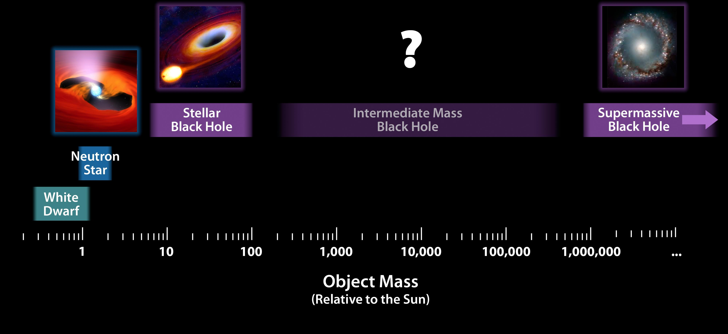
Local constraints to the BH occupation fraction in low-mass galaxies (<1e10 M☉) constrains TDE and LISA EMRI rates, as well as dominant seeding mechanism at high-z
Notes:
Dynamically ? ELTs are 10 yr away – takes dedicated survey with IFUs behind AO, both hemisphere
No other wavelength can do it (subeddington emission overshined by stellar emission in radio optical ir)
ELTs are 10 yr away – takes dedicated survey with IFUs behind AO, both hemispheres.
Or, wait for a Lynx-class mission – absence of evidence is not evidence for absence

Slide 3
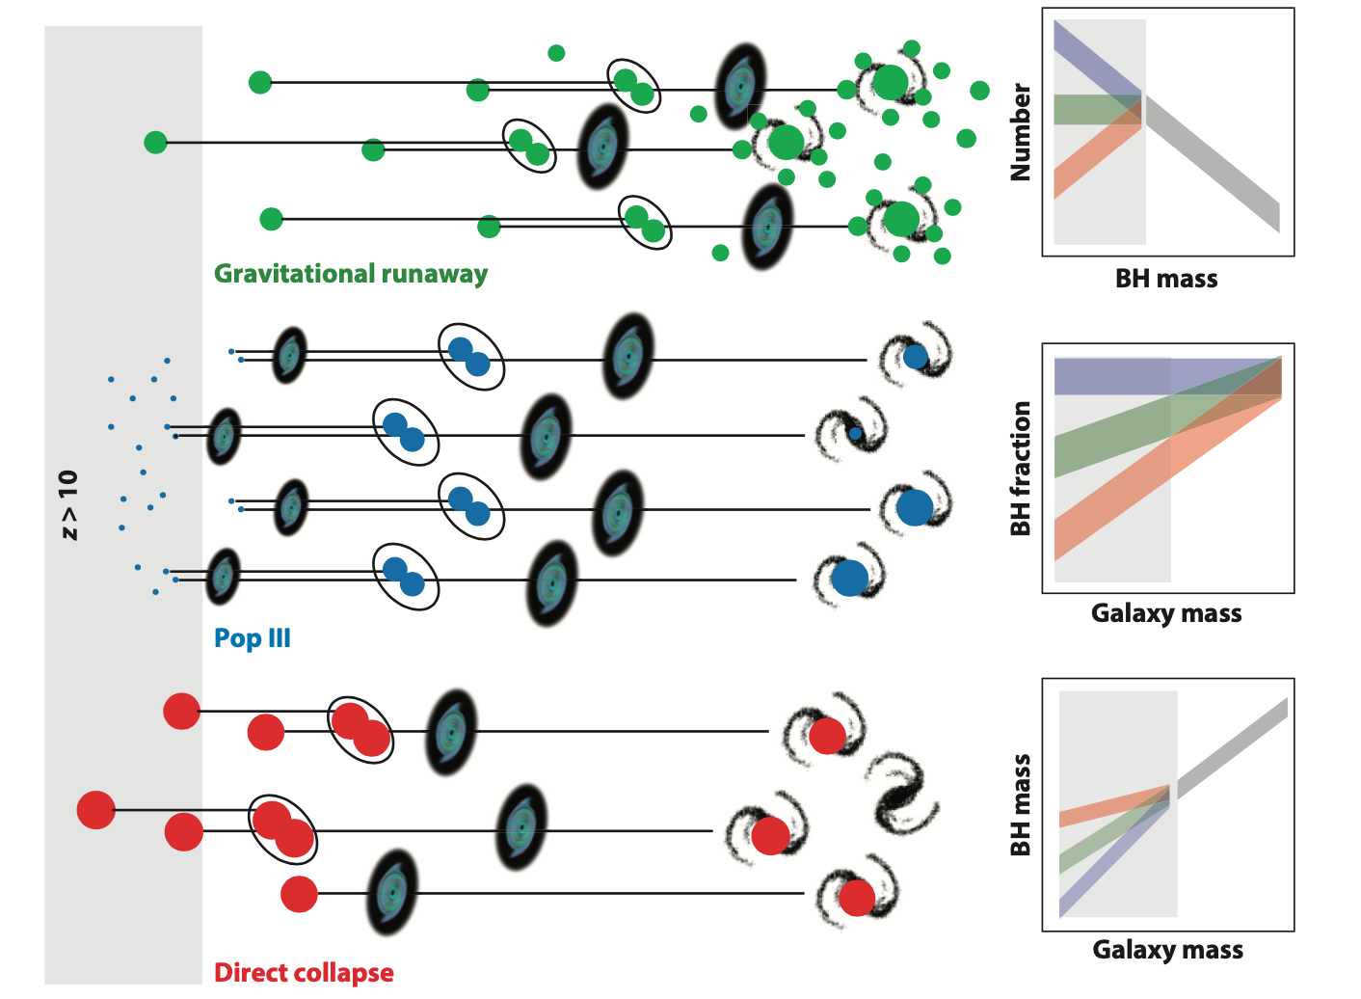
Greene+ 2020
Notes:
How to go from active to occupation

Slide 4
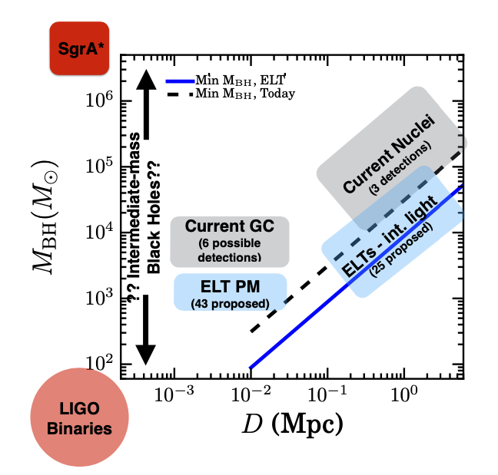
The low-mass end of the massive BH population
Small sphere of influence severely hampers dynamical identification below 1+e5 M (handful of detections/limits; Nguyen+ 2017-2020)
Search for actively accreting BHs instead
Massive seeds
Greene+ 2019 WP
Notes:
It is only natural that so far much of the efforts around populating the low mass end has focused on searching for AGN
Searches for low-mass/low-luminosity AGN started some 12 yrs ago with the seminal work by Luis Ho and Jeenny Greene and in fact constituted the bulk of Jenny’s PhD thesis work. Over a decade later, we are still hammering on the BRIGHT END / IN OTHER WPORDS THE TIP OF THE ICEBERG
Go after 1e4 solar mass BH within 5 Mpc (and 1e3 in adromeda) with adptive optics and IFU units on ELTs in both hemispheres

Slide 5
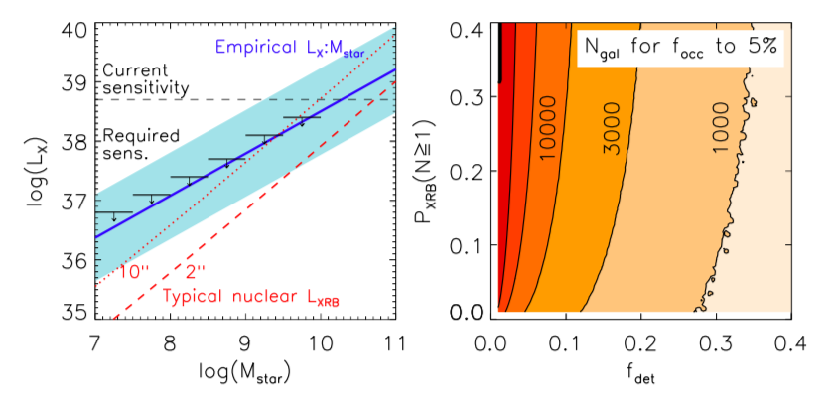
From (X-ray) active to occupation fraction Method
Chandra data show linear (log-log) Lx:M* relation*, with Gaussian scatter
Given Lx:M* , a non detection could arise from either insufficient sensitivity or absence of a BH
Fitting simultaneously for the relation’s slope and scatter allows to convert the detection fraction into an occupation constraint
NEED: low distance, high resolution, unform X-ray sensitivity
Gallo+ Astro2020 WP
Notes:
Active fraction => lower limit to occupation fraction
Very quickly, this method, which was pioneered by Brendan Miller some 5 yrs ago now, relies on a quantitative scaling between measured nuclear X-ray lum, and the host stellar mass (proxy for BH mass), shown in this plot as a shaded blue area. Since X-ray non detections could result from either insufficient sensitivity or real absence of a BH, fitting simultaneously for the relation’s slope and scatter allows to convert the active fraction into occupation fraction
In essence, given an occupation fraction function, the relationship predicts a detection rate at a given sensitivity (black lines), and the ratio of observed to expected number of detection constrains focc. Main complication in this is XRB contamination – whose probability we can addresses statistically given knowledge of the XLF. [here the dashed and dotted red lines show the average nuclear LX,XRB for a galaxy at d = 50 Mpc for two detection cell sizes. LX,XRB, combined with the XRB luminosity function13;23, yields the likelihood (PXRB) of detecting an XRB]. High resolution is key to reject off-nuclear XRBs and minimize this contamination.
ACTIVE IS AN ARBITRARY TERM

Slide 6
Given:
M* distr.
measured Lx:M* relation
O.F.
Prescription
After Miller+ 15
Notes:
Based on 100+100 early type targets – why early types – XRB contamination easier to deal with – ignore high-mass which scale with SFR
Focc. Below 1e10 higherthan 27% with 68% cponfidence – first step

Slide 7
Notes:
Based on 100+100 early type targets – why early types – XRB contamination easier to deal with – ignore high-mass which scale with SFR
Focc. Below 1e10 higherthan 27% with 68% cponfidence – first step

Slide 8
Notes:
Based on 100+100 early type targets – why early types – XRB contamination easier to deal with – ignore high-mass which scale with SFR
Focc. Below 1e10 higherthan 27% with 68% cponfidence – first step

Slide 9
Notes:
Based on 100+100 early type targets – why early types – XRB contamination easier to deal with – ignore high-mass which scale with SFR
Focc. Below 1e10 higherthan 27% with 68% cponfidence – first step

Slide 10
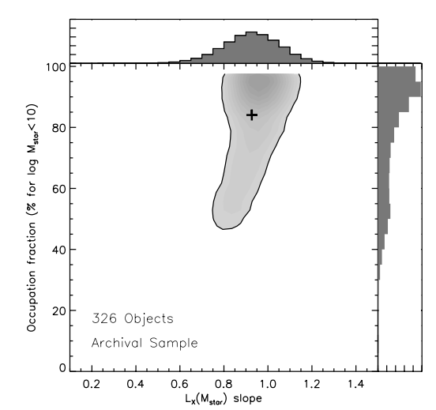
Occupation fraction – early types
f_{occ} (M*<1e+10 M☉)
326 early types
f_{occ} > 47% (68% C.L.)
f_{occ} >27% (99% C.L.)
Gallo & Sesana 19
Notes:
Some updated results from this method, from 326 galaxies with existing Chandra data within 30 mpc – lx down to 1e-6. Posterior distribution of the LX:Mstar slope vs. occupation fraction (taken as the median of 50,000 draws) below 1e10 msun. The occupation fraction is constrained above 45% (68% C.L.), with values <25% being ruled out with 99% confidence. Albeit not highly constraining this tend to disfavor heavy seeds [and I wish to point out that this is in contrast with a similar methodology applied to SDSS galaxies (higher stats, higher cont., more assumptions]
The power of this technique is that improving the constraint on focc only depends on increasing the sample
size of galaxies. The main complication is contamination from XRBs, which are distributed according to
the stellar surface density, and which have luminosities similar to the expected LX for weakly accreting
black holes. The contribution of confusing XRBs to the nuclear X-ray signal can be tightly constrained and accounted for if
the sample size is increased to improve the counting statistics; the essential effect is that the needed sample
size is also proportional to the chance contamination from a nuclear XRB.

Slide 11
New constraints: f_{occ} (M*<1e+10 M☉)
737 targets within 30 Mpc, uniform Chandra sensitivity logLx > 38.3
< f_{occ} >=53%
f_{occ} <35% & >85%
ruled out
Gallo+ in prep.
Notes:
Latest update – work in progress – XRB missing
Where we stand with current data – can only be improved 1. adding ~200 dwarfs – or more substantially with a lynx class mission

Slide 12
New constraints: f_{occ} (M*<1e+9 M☉)
737 targets within 30 Mpc, , uniform Chandra sensitivity logLx > 38.3
< f_{occ} >=23%
f_{occ .}>67% ruled out
Gallo+ in prep.
Notes:
Latest update – work in progress – XRB missing
Where we stand with current data – can only be improved 1. adding ~200 dwarfs – or more substantially with a lynx class mission

Slide 13
Summary
  Improved X-ray based constraints to the local BH occupation fraction in dwarf galaxies:
  To improve upon this:
  Lynx-class mission (5% precision)
f_{occ} <35% below 1e+9 Msun (95% C.L.)
< f_{occ} >=23%
Heavy seeds?

Slide 14
Next-gen, high resolution
X-ray imaging constraints
This approach can be generalized to predictions for measuring f_occ in 3 mass bins below 1e+9.5 M
Lynx HDXI can detect a 1e+37 erg/s source to 50 Mpc in ~50 ks, or to 75 Mpc in 100 ksec –> requires a mass dependent sensitivity
~3000 galaxies <100 Mpc needed for 5% f_{occ} precision in 0.5 dex mass bins within 10⁸< M∗/M⊙ < 10^{9.5}
Notes:
Main complication in this is XRB contamination – whose probability we can addresses statistically given knowledge of the XLF. [here the dashed and dotted red lines show the average nuclear LX,XRB for a galaxy at d = 50 Mpc for two detection cell sizes. LX,XRB, combined with the XRB luminosity function13;23, yields the likelihood (PXRB) of detecting an XRB]. High resolution is key to reject off-nuclear XRBs and minimize this contamination.

