Slide 1

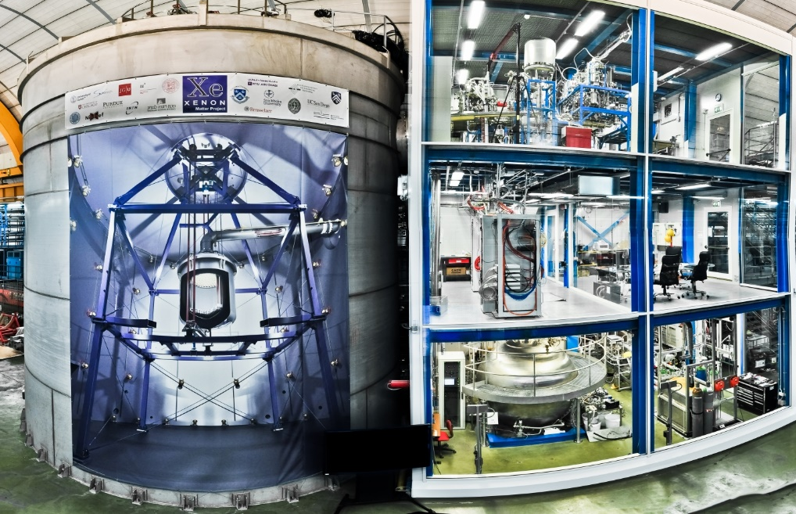
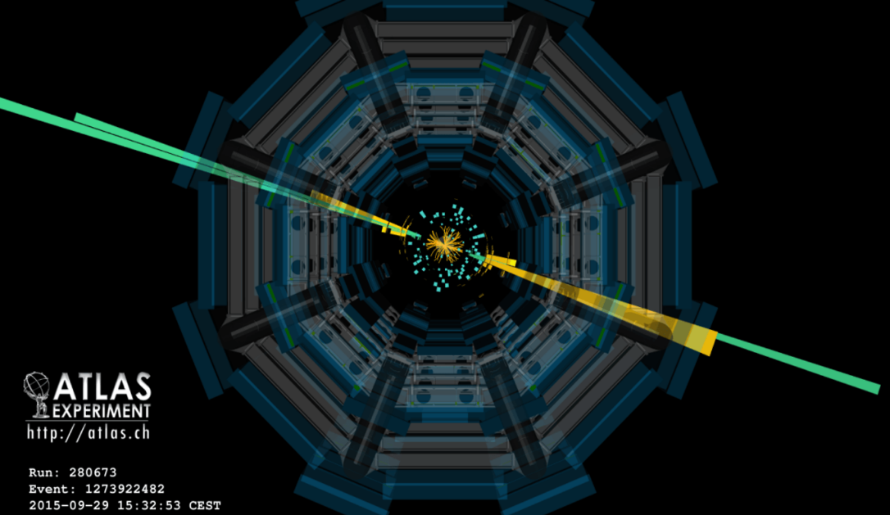
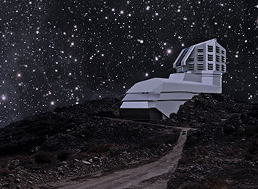
The Next Disruption in Cosmology
Rocky Kolb The University of Chicago

Slide 2
Disruption: the change in the traditional way that something operates, especially in a new and effective way.
Some 20th and 21st century disruptions impactful for cosmology:
The development of General Relativity
  Formulation by Einstein
  Eddington expedition
  Theory papers: Einstein, Friedmann, de Sitter, Lemaître, …
  Observational discoveries: Hubble, …
The Quantum Revolution
  Atomic physics, Nuclear physics, Particle physics
The discovery & exploitation of the CMB
  Penzias & Wilson, spectrum, fluctuations, etc.
The emergence of the standard model of particle physics
  The “discoveries” of dark matter and dark energy

Slide 3
Disruption: the change in the traditional way that something operates, especially in a new and effective way.
The most disruptive disruptions disprove something:
Discovery of the expansion of universe disproved static, eternal cosmological model.
Discovery of CMB disproved steady-state model.
Discovery of CMB fluctuations disproved baryon isocurvature model.
Discovery of acceleration of expansion disproved Einstein-de Sitter model.

Slide 4
Disruption: the change in the traditional way that something operates, especially in a new and effective way.
Sometimes disruptions are discoveries that something doesn’t exist:
Michelson-Morley experiment.
Proton doesn’t decay as predicted by SU(5) GUTs.
Structure formation not driven by cosmic strings (or other topological defects).
Electroweak scale SUSY isn’t there?
Dark matter isn’t a “standard” WIMP?

Slide 5
Disruption: the change in the traditional way that something operates, especially in a new and effective way.
In my opinion the wildly successful phenomenological ΛCDM model is ripe for disruption.
Features of ΛCDM :
Dark matter
Dark energy
Baryon asymmetry
Structure forms from gravitational instability
Baryon asymmetry arises through dynamical process
Inflationary origin of curvature density fluctuations

Slide 6
Why Disrupt Precision Cosmology?
Cosmological Parameters:
T₀ = 2.7255 ± 0.0006 K
Ω₀ = 1.005 ± 0.005
Ω_{M} = 0.315 ± 0.01
Ω_{B} = 0.048 ± 0.001
Ω_{DE} = 0.685 ± 0.01
H₀ = 67 ± 1.2 km s⁻¹ Mpc⁻¹
t₀ = 13.80 ± 0.02 Gyr
n_{s} = 0.965 ± 0.005
N_{ν} = 3.0 ± 0.33
Concepts:
Structure forms from curvature
seeds à la CDM.
Universe is spatially flat.
Universe topology is trivial.
On large scales Universe is homogeneous and isotropic.
Dynamics of expansion described by Friedmann equation.
GR is valid on all scales.
No BSM long-range forces.
No BSM particles with mass less than weak scale.

Slide 7




Why Disrupt Precision Cosmology?
Precision  Accuracy
Precision
Accuracy
Precision without accuracy
Accuracy without precision

Slide 8
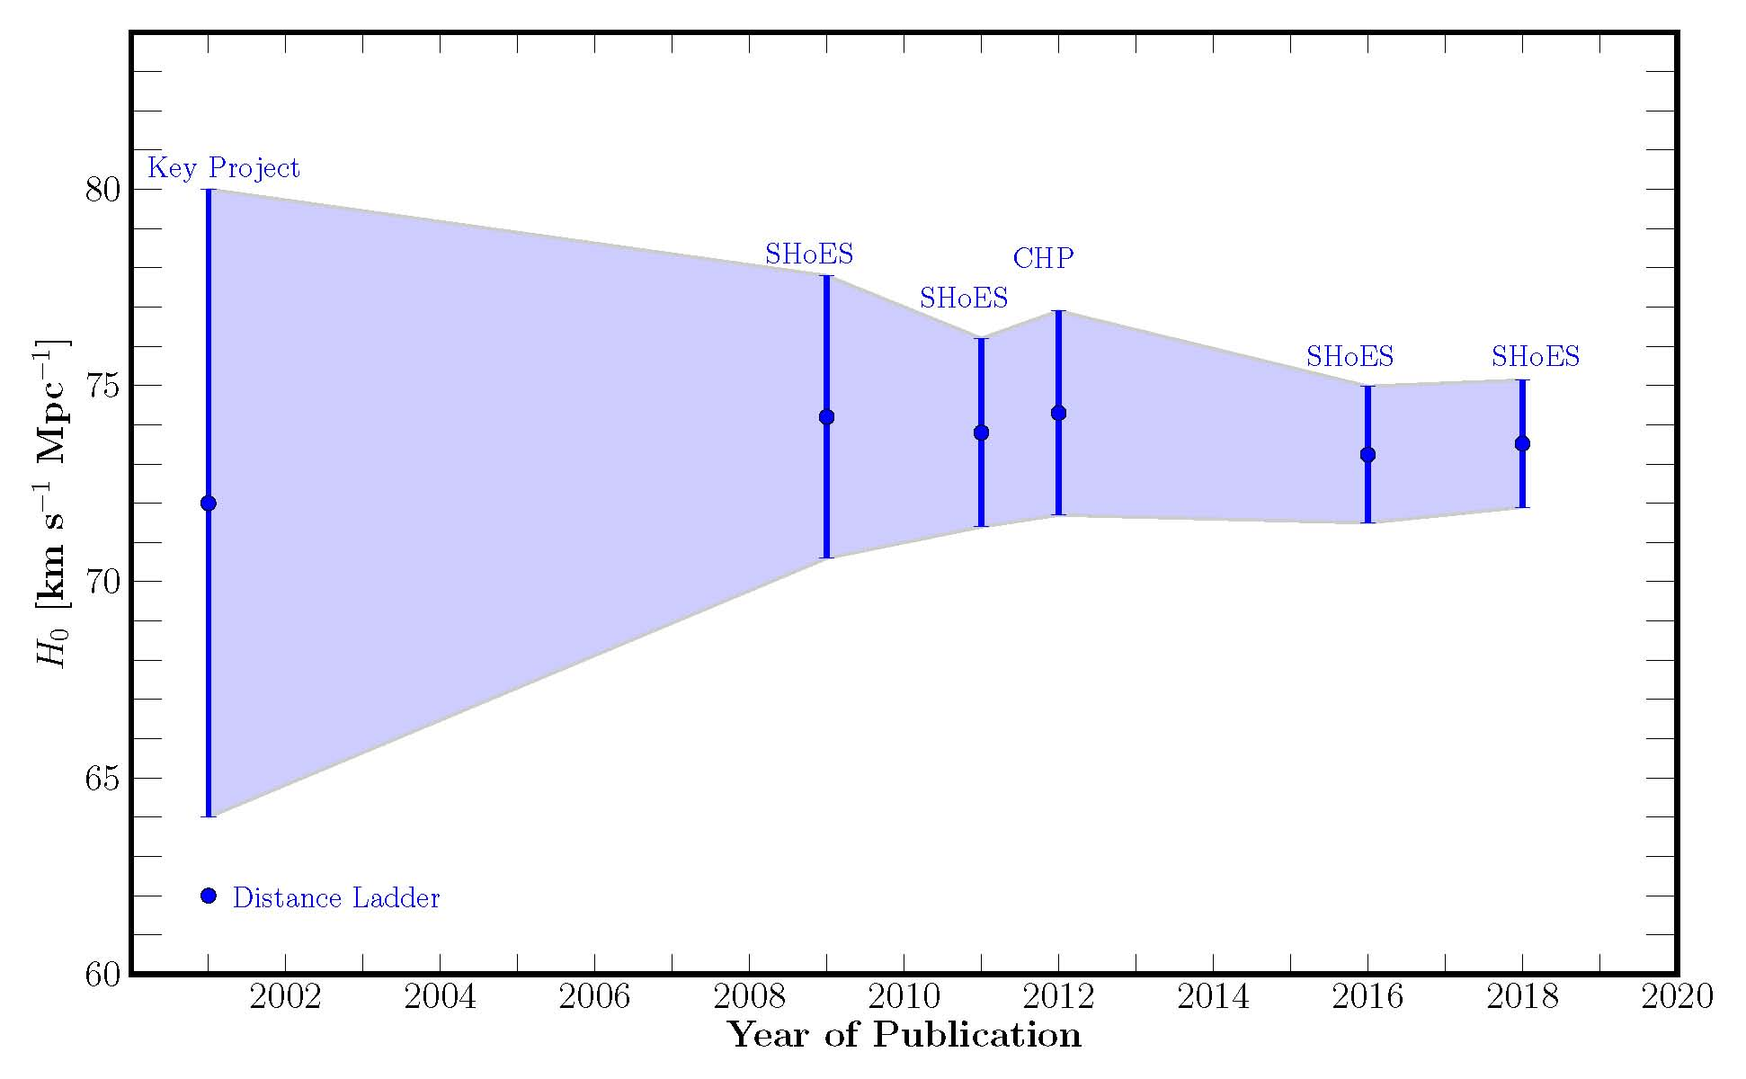
What Disruption Might Look Like
After Freedman, Nature Astronomy
Traditional distance ladder results have been (too?) consistent (consistent  correct!) since at least 2001; seems to be converging on H₀ = 73.52 ± 1.62. (Riess at al. 1804.10655)
Notes:
Confirmation Bias

Slide 9
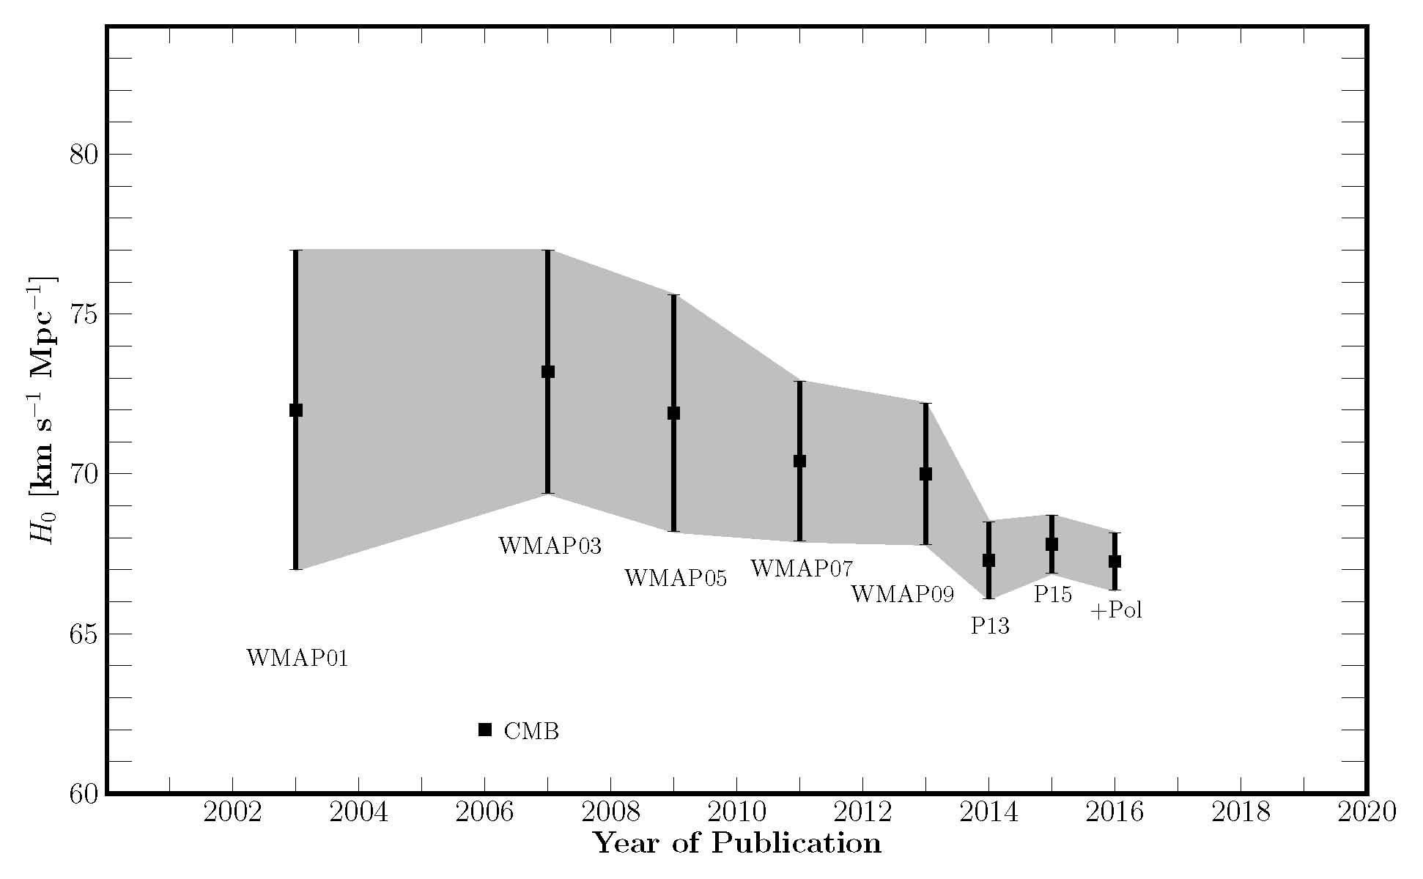
What Disruption Might Look Like
After Freedman, Nature Astronomy
CMB + ΛCDM model, results have been (sort-of?) consistent (consistent  correct!) since at least 2001; seems to be converging on H₀ = 67.26 ± 1.2. (Planck collaboration)
Notes:
Confirmation Bias

Slide 10
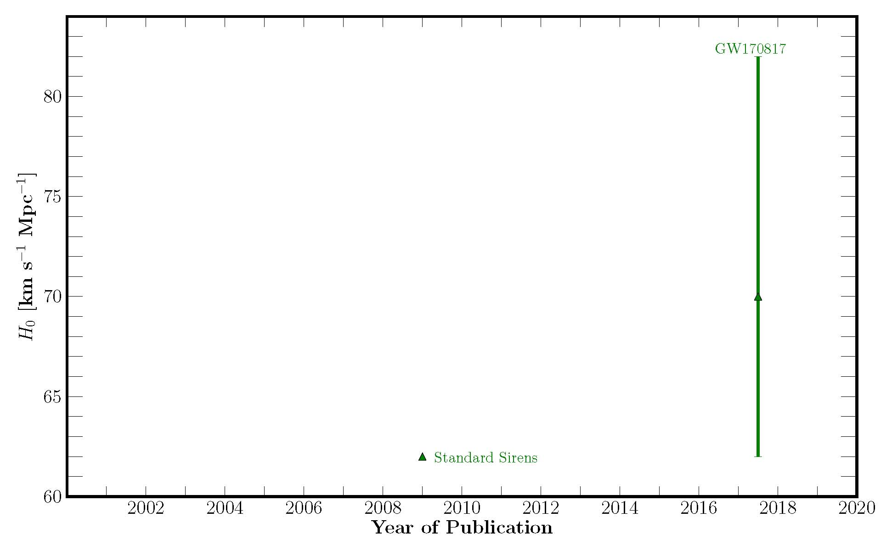
What Disruption Might Look Like
After Freedman, Nature Astronomy
Standard Sirens (gravitational waves) promising; not yet competitive. (arXiv:1710.05835
Notes:
Confirmation Bias

Slide 11
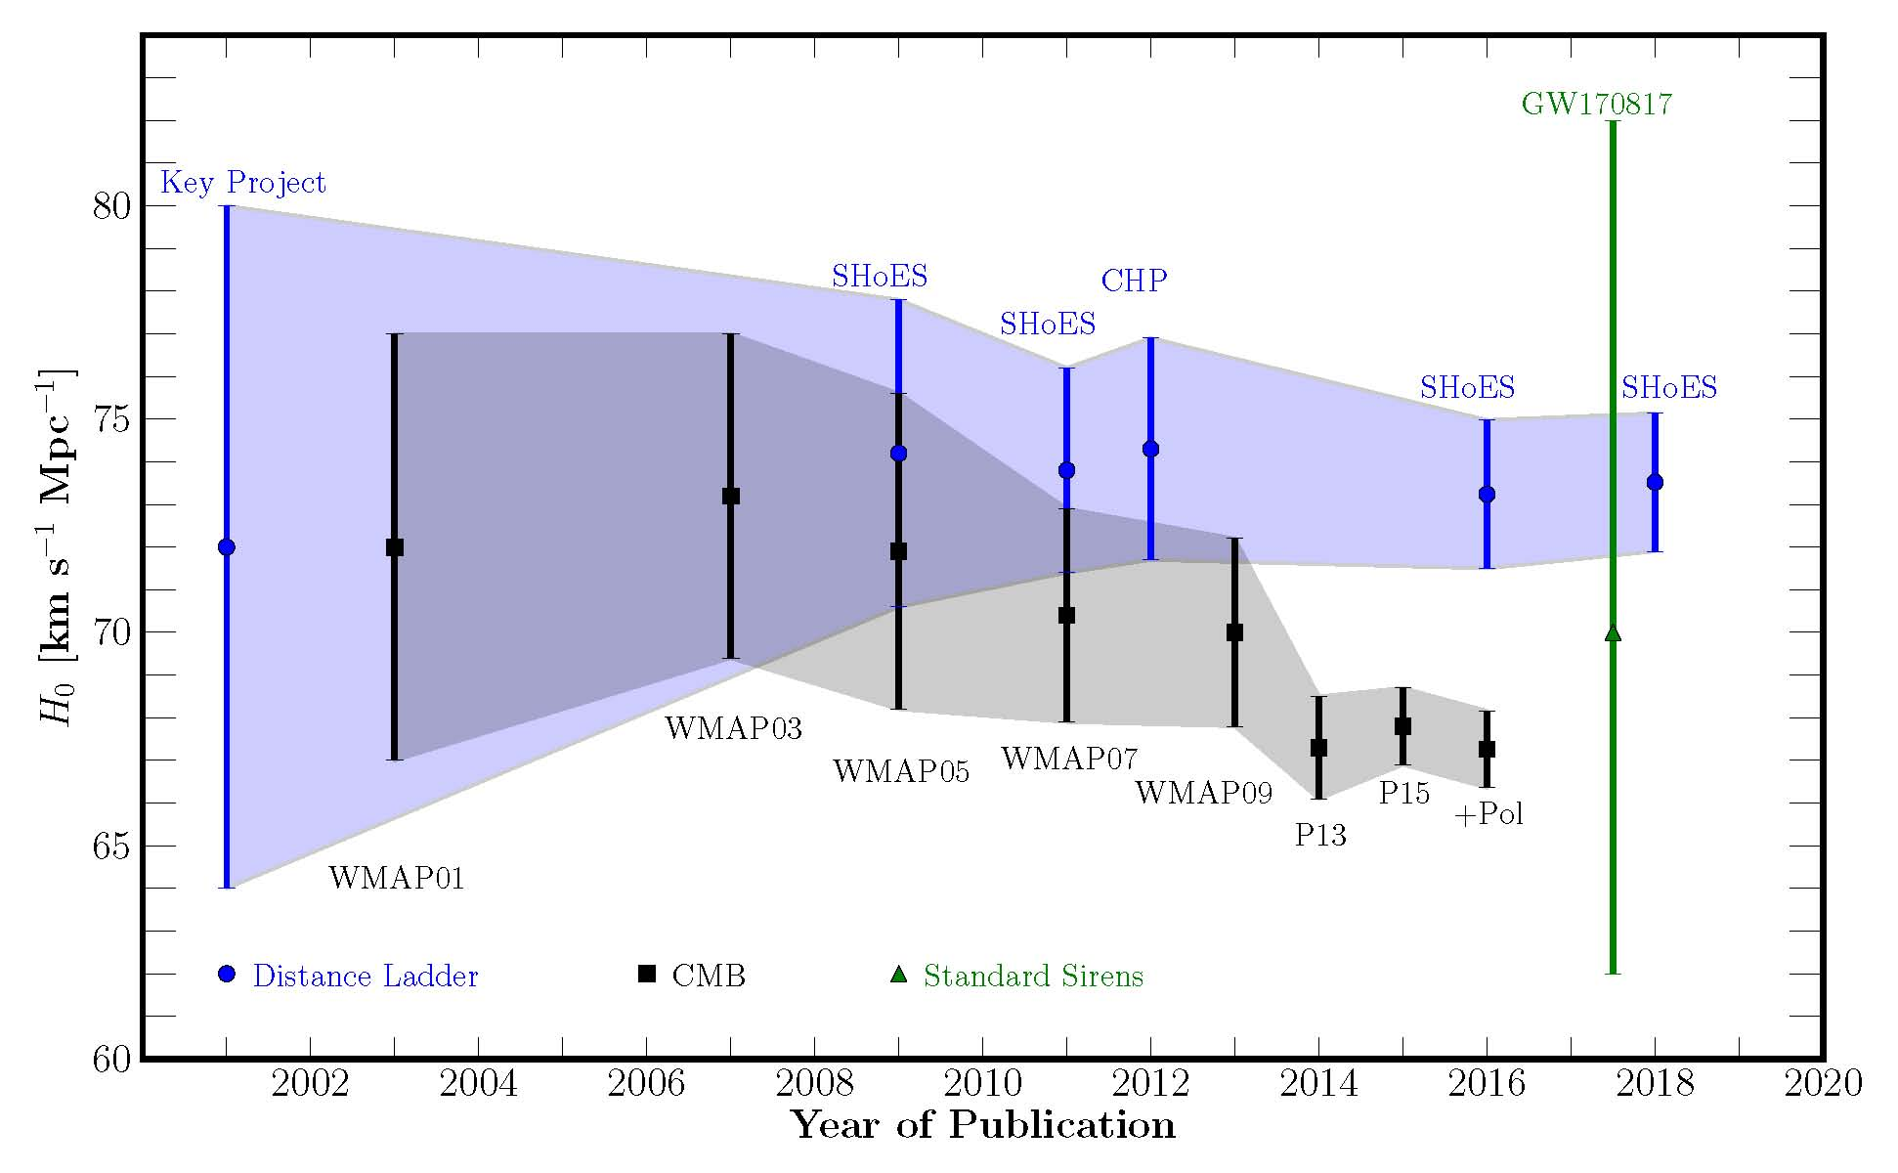
What Disruption Might Look Like
2025: String theory +
anthropic principle → h = 1/2
H₀ = 70.71068 ... km s⁻¹ Mpc⁻¹
After Freedman, Nature Astronomy
Traditional distance ladder results have been (too?) consistent (consistent  correct!) since at least 2001; seems to be converging on H₀ = 73.52 ± 1.62. (Riess at al. 1804.10655)
CMB + ΛCDM model, results have been (sort-of?) consistent (consistent  correct!) since at least 2001; seems to be converging on H₀ = 67.26 ± 1.2. (Planck collaboration)
Standard Sirens (gravitational waves) promising; not yet competitive. (arXiv:1710.05835)
On the face of it, a 3.8σ disruption! What to make of this?
Notes:
Confirmation Bias

Slide 12
What To Make of H₀ Tension?
Don’t make anything of it, wait until it is 5σ.
Perhaps there will be no discrepancy and H₀ resumes its role as a nuisance parameter.
Perhaps error estimates for distance ladder results are underestimated ... after all, it involves astronomy.
Perhaps error estimates for Planck CMB results are underestimated … not great agreement with WMAP.
Perhaps both are underestimated (not either/or).
Or real disruption: both techniques are correct and there is a statistically significant discrepancy.
    Six-parameter ΛCDM model is incomplete.
      Extra relativistic degrees of freedom changes CMB result
      Expansion rate history not well described by ΛCDM (more later)

Slide 13
ΛCDM
Inflation produced a mostly smooth, spatially flat universe with seeds of structure and background gravitational waves from quantum fluctuations.
Somehow after inflation a small cosmological constant remained, which acts today as dark energy.
After inflation universe defrosted producing the primordial plasma (usually referred to as reheating).
A baryon asymmetry arose after inflation through some dynamical process know as baryogenesis.
Dark matter was produced from the primordial soup.
Key input: GR + Standard Model of Particle Physics

Slide 14
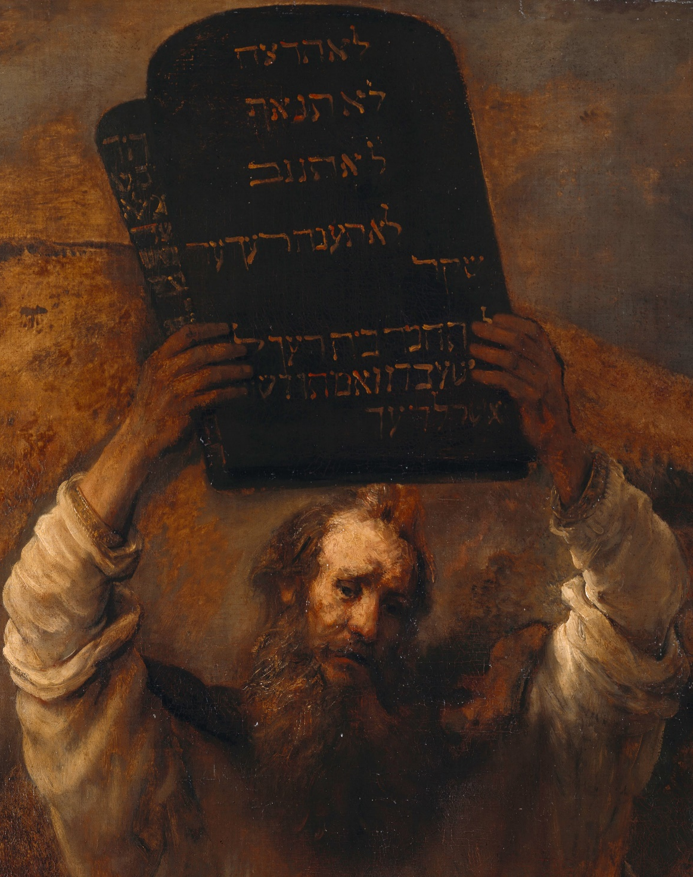





Ten Commandments of Modern Genesis
Left-hand side
Right-hand side
Standard model of particle physics
General
Relativity
Gemäldegalerie

Slide 15
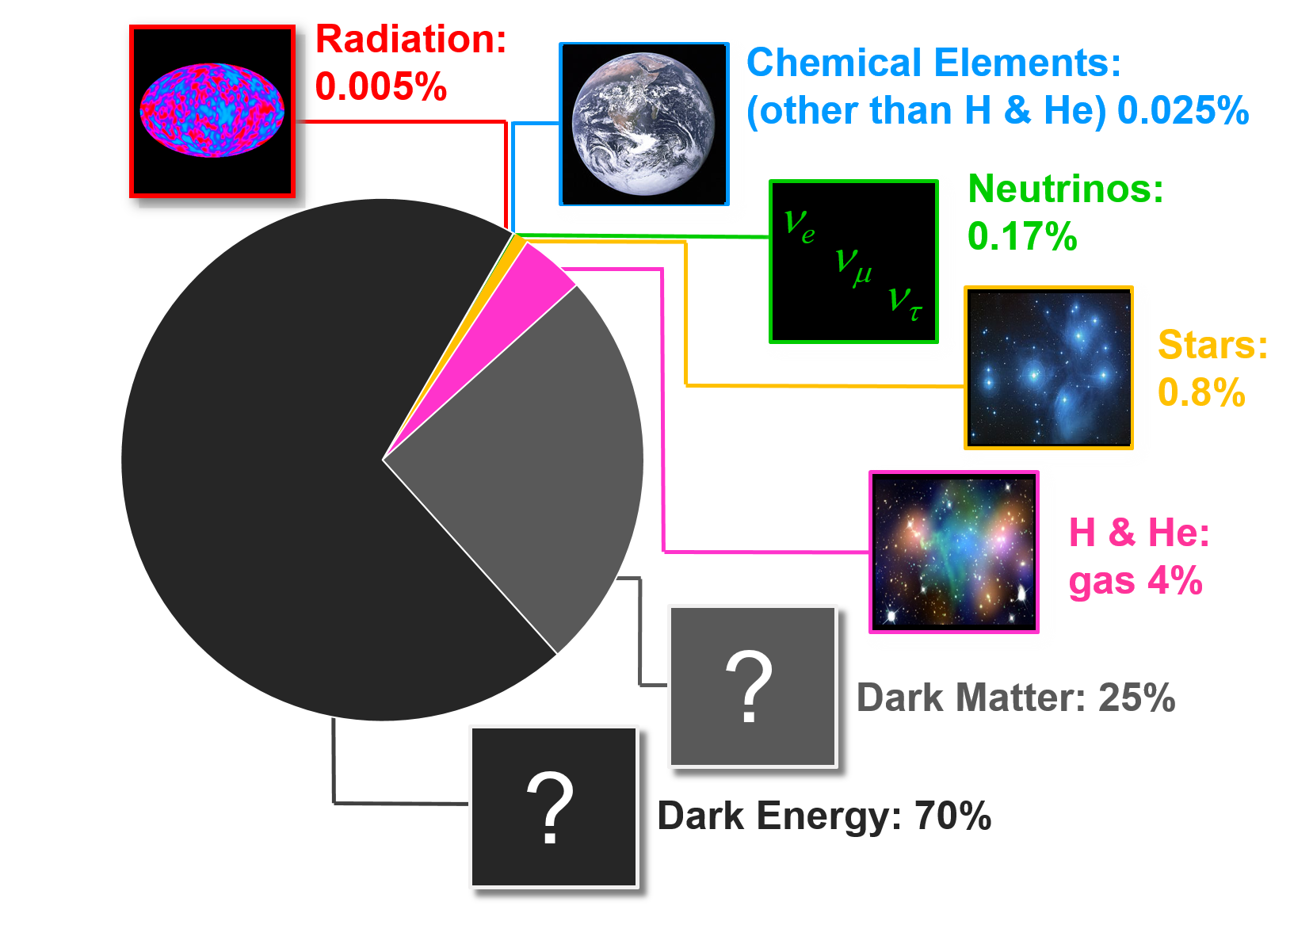
95% of the Mass/Energy
of the Universe is Mysterious
UNSOLVED PROBLEMS in Astrophysics and Cosmology
Notes:
Opik, Oort 1932, Jeans, Lemaitre 1933 obscure matter, Zwicky 1933 & 1937

Slide 16
Dark Matter and Structure Formation
It exists!!! Thank you astronomy!
What is the local DM phase-space velocity distribution?
What is the local value of ρ_{DM} ?
Are there nearby DM subclumps?
What is the background for γ -ray emission from the galactic center?
What is ρ_{DM} (r)
Is DM multi-component like visible matter?
Does DM have self-interactions?
Does DM have normal gravitational interactions?
very near the galactic center?
in dwarf spheroidals?
in DM subclumps?
(a complete theory containing dark matter could answer the last three)
UNSOLVED PROBLEMS in Astrophysics and Cosmology

Slide 17
Golden Goals
Particle Physics:
  Understand the nature of dark matter (DM) and how it is embedded into a deeper theoretical framework:
    If DM is a particle, want to know more than just its mass, spin,
    and couplings, want to know how it fits into a model or theory
    Want to know why DM exists
    Want to understand its contribution to the mass budget
Astrophysics:
Understand the role of DM in the evolution of the universe and structure formation:
  Is the DM completely cold?
  Is there only one DM component?
  Does DM have interactions that affect structure formation?
Will it take a disruption?
UNSOLVED PROBLEMS in Astrophysics and Cosmology

Slide 18
What Would be a Dark Matter Disruption
Particle Physics:
  Accelerator discovery of dark matter
  Accelerator discovery of beyond standard model (BSM) physics
  Direct detection of dark matter
  Compelling evidential theory for dark matter
  Falsify equivalence principle
  Discovery of new long-range force
Astrophysics:
Indirect detection of dark matter (annihilation or decay signature)
Evidence that dark matter is collisional
Evidence that dark matter is warm or has a hot component
Evidence that dark matter decays
UNSOLVED PROBLEMS in Astrophysics and Cosmology

Slide 19
Particle Dark Matter Bestiary
(sub-) eV mass neutrinos (WIMPs exist!) (hot)
sterile neutrinos, gravitini (warm)
lightest supersymmetric particle (cold)
lightest Kaluza-Klein particle (cold)
Bose-Einstein condensates
axions, axion miniclusters
solitons (Q-balls, B-balls, …)
supermassive WIMPZILLAs from inflation
thermal relics, or decay of or oscillation from
thermal relics
from phase
transitions
nonthermal relics
Mass
10⁻²² eV (10⁻⁵⁶ g) Bose-Einstein
10⁻⁸ M_{ʘ} (10⁺²⁵ g) axion miniclusters
Interaction Strength
only gravitational: WIMPZILLAs
strongly interacting: B balls
UNSOLVED PROBLEMS in Astrophysics and Cosmology
Notes:
Axion miniclusters Hogan and Rees
Won’t discuss axions, 3.5 keV neutrinos, sterile neutrinos, etc.
Concentrate on cold thermal relics

Slide 20
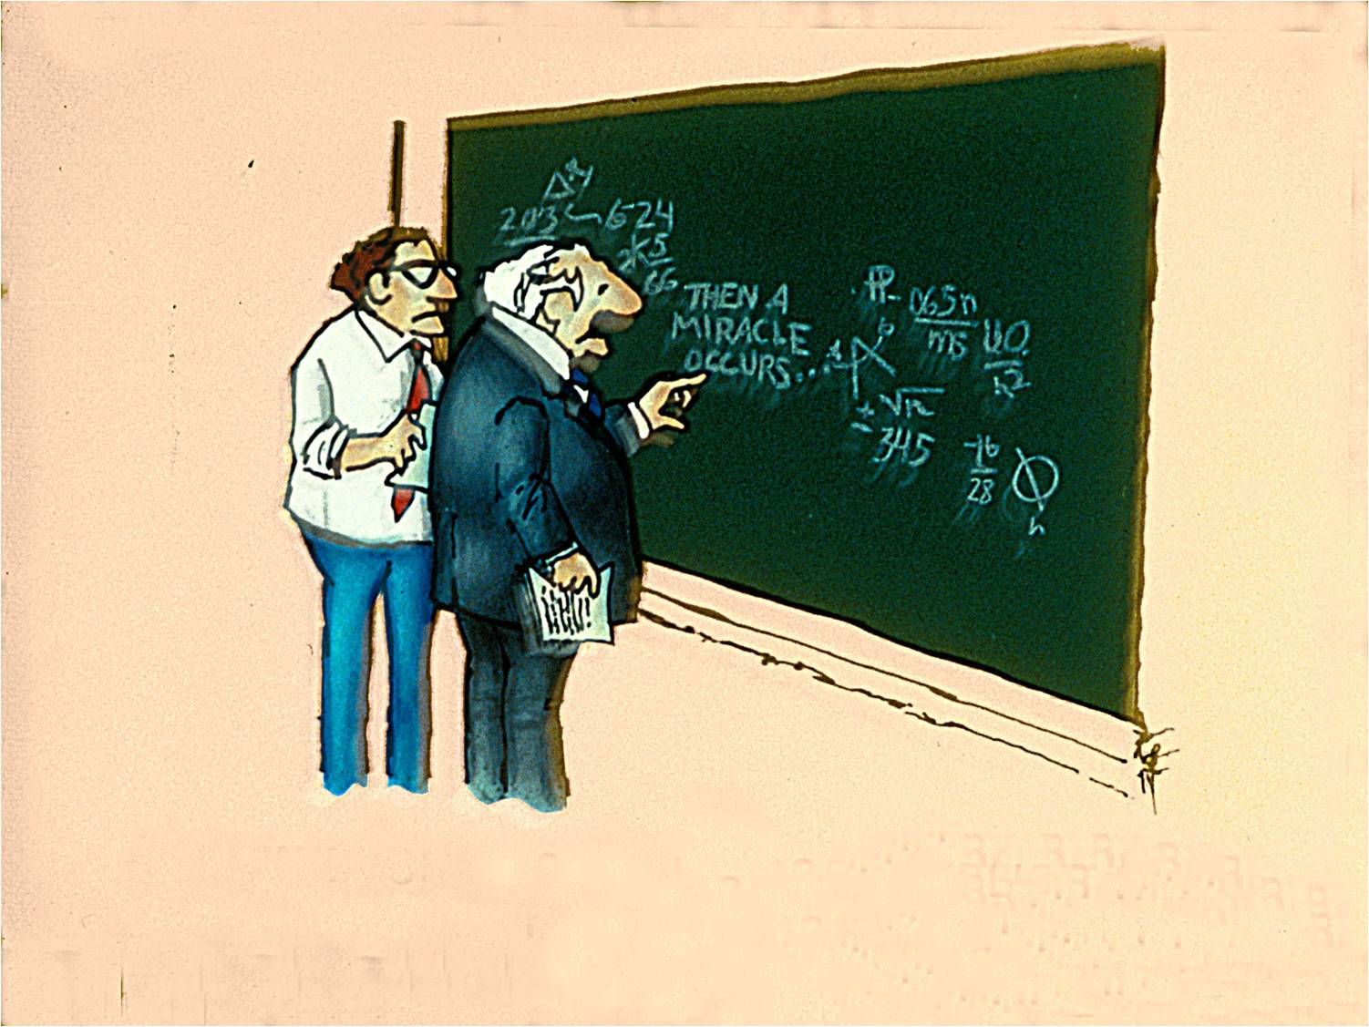



The WIMP “Miracle”
mir·a·cle
\ˈmir-i-kəl \
noun
1 : an extraordinary event manifesting
divine intervention in human affairs
S. Harris
… often used to give an impression of great and
unusual value in a trivial
context …
I think you should be more
explicit here in step two
UNSOLVED PROBLEMS in Astrophysics and Cosmology

Slide 21
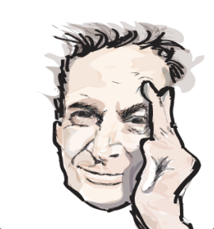
WIMPs Interact with SM Particles
Indirect Detection
Relic Abundance
STANDARD-MODEL
PARTICLE
WIMP
Direct
Detection
STANDARD-MODEL
PARTICLE
WIMP
Collider Production

Slide 22
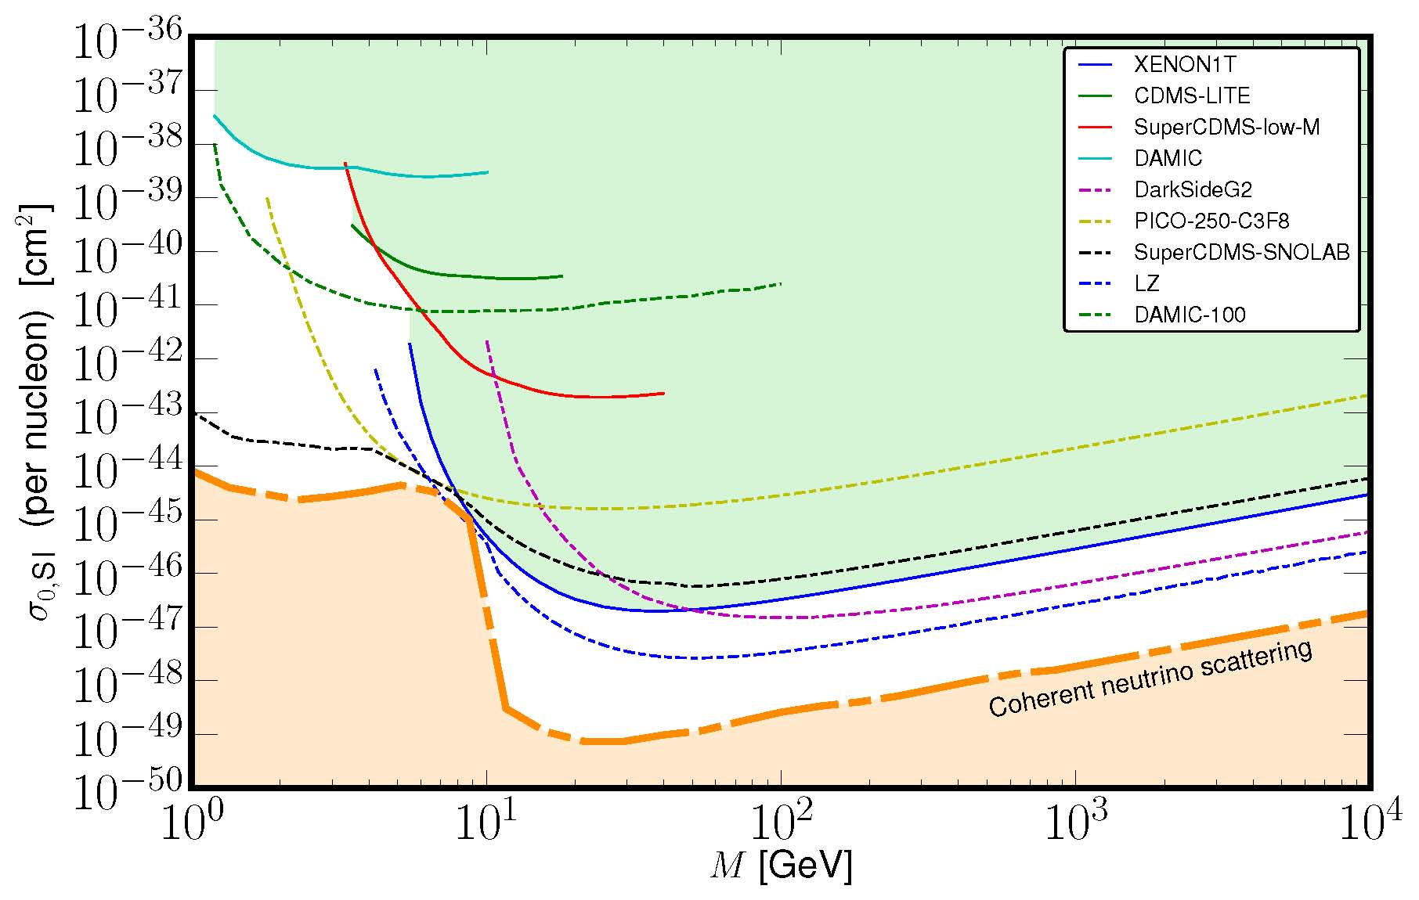
Direct Detection
Spin-Independent Scattering
10⁻³⁶ cm² = 1 picobarn
10⁻³⁹ cm² = 1 femtobarn
10⁻⁴² cm² = 1 attobarn
10⁻⁴⁵ cm² = 1 zeptobarn!
10⁻⁴⁸ cm² = 1 yoctobarn
M. Fedderke

Slide 23
Direct Detection: The Future
The path is clear (at least to me)
(Goal is to discover WIMP or kill a 40-year old idea.)
Push spin-independent limits down to neutrino background – about 2 orders-of-magnitude below current experiments
Lot of white space for spin-dependent limits
Push sensitivity to lower WIMP mass (new techniques?)
If see a signal:
  Seasonal variations
  Different targets
  Directional sensitivity
If don’t see a signal:
  Think beyond nuclear recoil
  Work on 21cm astrophysics

Slide 24
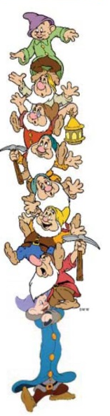
Indirect Detection: The Future
The path is clear (at least to me)
(Goal is to discover WIMP or kill a 40-year old idea.)
Have an overwhelmingly statistically significant γ -ray excess from GC
Why aren’t we all as excited as Dan Hooper?
Possible background contamination (thousands of millisecond pulsars, …)
Better astrophysical understanding of galactic center
Better understanding of dark-matter density profile
Better observations
  Better angular resolution
  (resolve background sources, remove emission correlated with gas, …)
  Better spectral resolution
  More collecting area—look for signals elsewhere, stacked dwarfs, etc.
  Ground observations, e.g., CTA will teach us about backgrounds

Slide 25
Collider Searches: The Future
The path is clear (at least to me)
(Goal is to discover WIMP or kill a 40-year old idea.)
LHC is running at 13 TeV
LHC is accumulating a tremendous amount of data
If DM is a SUSY relic, some indication of SUSY will be (should have been?) discovered at LHC:
  gluinos, squarks, charginos, will be seen first
  search strategies well developed
  weak-scale SUSY is on life support
If DM is a Maverick particle with no similar-mass friends:
  only hope is missing-energy searches
  most effective for low masses
  no guarantee EFT valid at LHC

Slide 26
Dark Matter: If Not a WIMP
If DM not a WIMP, many other possibilities:
  Axions
  Asymmetric DM
  Sterile neutrino DM (e.g., 7 keV sterile neutrino producing 3.5 keV X-ray line which may, or may not, be observed)
  Axino (7 keV axino) DM
  Self-interacting DM
  Inelastic DM
  Q-balls or other solitonic DM
  Quark nuggets
  Hidden-sector DM
  WIMPzilla
Notes:
XMM-Newton & Chandra

Slide 27
Dark Matter: The Future
We are in the eighth decade of Dark Matter!
2010s is the Decade of the WIMP
  LHC
  Direct detection
  Indirect detection
  Have to run to ground the WIMP (cold thermal relic) hypothesis.
Indirect/Direct/LHC confusion not an issue
WIMPs may be more complicated: Leptophilic, Leptophobic, Flavorful, Self-Interacting, Dynamical, Inelastic, …
My predictions:
  We will know the answer before a century of dark matter
  Dark matter discovery will be
    unanticipated
    “none of the above”
    multicomponent
    part of an entire dark sector

Slide 28
95% of the Mass/Energy
of the Universe is Mysterious
Baryon
Asymmetry
Baryon
Asymmetry
Baryon
Asymmetry
UNSOLVED PROBLEMS in Astrophysics and Cosmology

Slide 29
99.825% of the Mass/Energy
of the Universe is Mysterious
Baryon
Asymmetry
Baryon
Asymmetry
Baryon
Asymmetry
UNSOLVED PROBLEMS in Astrophysics and Cosmology

Slide 30
Baryon Asymmetry: n_{B}/s = (0.861 ± 0.005) × 10 ⁻¹⁰
Why is there an asymmetry between matter and antimatter?
  Initial (anthropic?) conditions:
    Requires “acausal” initial conditions.
    Inflation, which seemingly evades acausal issue for density perturbations, dilutes pre-inflation baryon number by an exponential amount.
  The modern perspective is that reheating after inflation produced a symmetric universe (equal abundances of matter & antimatter).
  Asymmetry developed dynamically after inflation and reheating through a process known as “baryogenesis.”
Why is it about 10⁻¹⁰ ?
UNSOLVED PROBLEMS in Astrophysics and Cosmology

Slide 31
Inner Space/Outer Space Connection
A complete Standard Model of Particle Physics, arising from laboratory experiments and beautiful theoretical ideas, should be applicable to the universe beyond terrestrial laboratories and (in principle) allow the calculation of cosmological parameters such as the baryon number of the universe, as well as the nature of dark matter and dark energy.
A failure of today’s Standard Model of Particle Physics to account completely for the observed universe (dark matter, dark energy, inflation, baryogenesis) points to the fact that Today’s Standard Model of Particle Physics is not the Final Standard Model of Particle Physics.
Cosmological considerations may point to directions for physics beyond today’s Standard Model.
UNSOLVED PROBLEMS in Astrophysics and Cosmology

Slide 32
Baryon Asymmetry: n_{B}/s = (0.861 ± 0.005) × 10 ⁻¹⁰
Can the standard model of particle physics explain a tiny number in the standard model of cosmology: n_{B}/s = (0.861±0.005) × 10 ⁻¹⁰ ?
No, or at least, not yet!
Can the standard model of particle physics explain an order-unity number in the standard model of cosmology: Dark Matter/Baryons ≈ 5.3?
No, or at least, not yet!
Starting after inflation/reheating with a symmetric universe, how must the SM be augmented to produce an asymmetric universe?
UNSOLVED PROBLEMS in Astrophysics and Cosmology

Slide 33
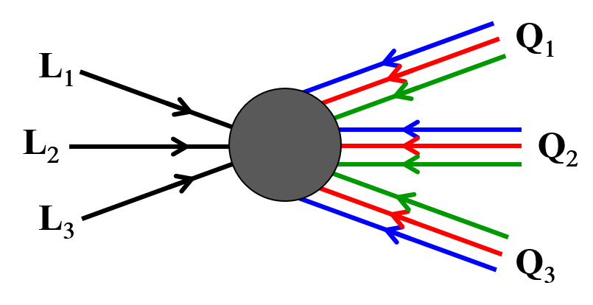
Sakharov Criteria in the Standard Model
Baryon number violating processes:
C and CP violating processes:
Nonequilibrium conditions:
Zero temperature:
Γ ∝ e ≈ 10⁻¹⁷¹
Non-zero temperature:
↑h ≠ 0
↑h = 0
’t Hooft
Yes in SM
(nonperturbatively)
Conserves B − L
−16π ²/g ²
Klinkhamer & Manton
Yes in SM
Direct CP violation
(CKM)
But value in standard model way too small.
Gavela, Hernandez, Orloff, & Pene
No in SM and
standard cosmology
Requires electroweak phase transition to be 1st-order.
UNSOLVED PROBLEMS in Astrophysics and Cosmology

Slide 34

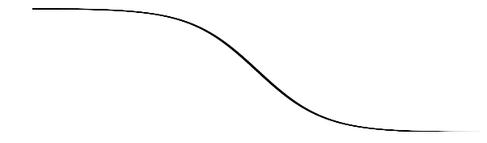
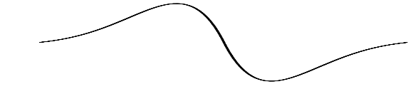

Electroweak Baryogenesis
Kuzmin, Rubakov, Shapashnikov;
Cohen, Kaplan, Nelson
Primordial
Plasma
In 1st-order EWK phase transition nucleate broken-phase bubble in symmetric phase background
(phase coexistence → nonequilibrium conditions).
↑h = 0
↑h = 0
↑h ≠ 0
↑h = 0
Broken phase expands into unbroken phase.
In broken phase sphalerons suppressed exp(−E_{sph}/T),
while in symmetric phase sphalerons unsuppressed.
↑h = 0
V_{Wall}
↑h ≠ 0
ΔB = H
↑h = 0
ΔB ? H
If CP in Higgs/fermion interactions, different transmission & reflection of left & right-handed quarks at the wall leads to CP asymmetry at wall.
Sphalerons violate B, convert CP asymmetry to baryon asymmetry in front of wall.
Baryon asymmetry diffuses into broken phase across wall.
h
CP
B
UNSOLVED PROBLEMS in Astrophysics and Cosmology

Slide 35
Electroweak Baryogenesis
Problems:
Phase transition not 1st-order in the Standard Model (Higgs mass too large; need m_{h}  72 GeV).
too small in the Standard Model.
Wall velocity may be too large. As V_{wall} → 1, wall moves too fast for baryon asymmetry to diffuse into broken-phase bubbles.
CP
Bad News: Electroweak baryogenesis doesn’t work within the Standard Model.
Good News: May point to directions BSM.
UNSOLVED PROBLEMS in Astrophysics and Cosmology

Slide 36
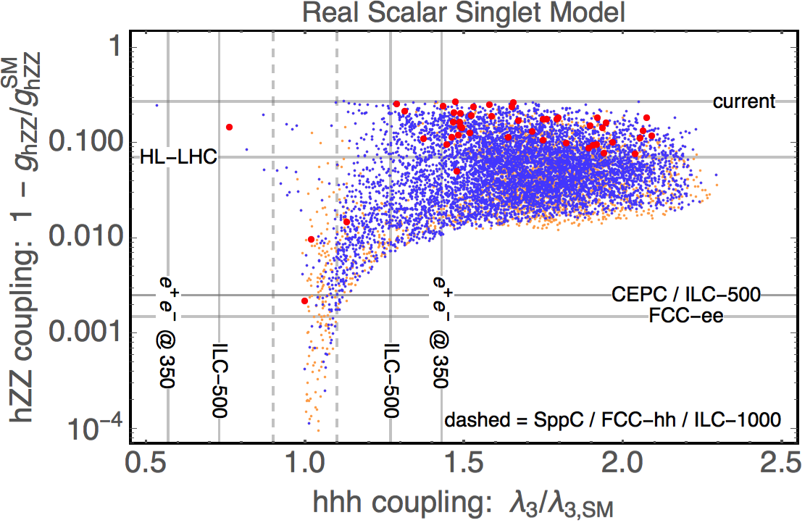
Electroweak Baryogenesis
Probe of models with 1st-order phase transitions (Huang, Long, Wang).
real scalar singlet S (m_{H} / 2 < m_{S}  TeV) interacting with SM through Higgs portal Φ†Φ
V(S) = S ² + S ³ + S ⁴ + Φ†Φ S ² + Φ†Φ S
Points represent models with 1st-order phase transition
  orange = too weak for baryogenesis
  blue = viable baryogenesis
  red = viable baryogenesis + detectable GWs
Many models with detectable
Δ(hZZ) also result in eLISA gravitational wave signal.
eLISA (launch 2034)
1 − g_{hZZ} /g_{hZZ,SM}
g_{hhh} /g_{hhh,SM}
(Huang, Long, Wang)
UNSOLVED PROBLEMS in Astrophysics and Cosmology
(Huang, Long, Wang)
Notes:
5 new parameters. Evolved LISA. Launch 16 years

Slide 37
Electroweak Baryogenesis
Probe of models with 1st-order phase transitions (Huang, Long, Wang).
Same qualitative results for other models
Significant deviations in hZZ-coupling, large (1) deviation in hhh-coupling. Discoverable at future colliders. Disruption.
Very strong 1st-order transitions lead to detectable gravitational waves. Disruption.
  Gravitational waves produced by
    Collision of bubbles,
    Decay of magnetohydrodynamic turbulence,
    Propagation of sound waves.
Measurement of neutron electric dipole moment would be disruptive.
UNSOLVED PROBLEMS in Astrophysics and Cosmology
Notes:
5 new parameters. Evolved LISA. Launch 16 years

Slide 38
Thermal Leptogenesis
(Fukugita & Yanagida)
Type-I see-saw model (Gell-Mann, Ramond & Slansky; Yanagida; Mohapatra & Senjanovic; Schecter & Valle) for neutrino masses and mixing enlarges the SM to include a Majorana neutrino N with a large mass which couples to SM leptons and Higgs via ☹ = − λ L H N.
Large Majorana mass for N; small Dirac mass for ν (generated by EWK Higgs mechanism). The see-saw results in light neutrino mass of
m_{ν} ≈ 0.3 eV (λ / 0.1)² (10¹² GeV /m_{N}) ² → so want m_{N} ≈ 10¹² GeV.
N decays to SM leptons + Higgs, violating lepton number by 1:
  N → L H or N → L H Lepton-number violation.
  Assume Γ(N → L H )  Γ(N → L H ) CP violation.
  If nonequilibrium conditions, can generate a lepton asymmetry with B − L  0.
  Sphalerons destroy B + L at T  100 GeV, conserve B − L always.
  If start with initial L_{i} ≠ 0 & B_{i} = 0, end with B_{f} = − L_{i} / 2.
  (Actually B_{f} = − 28 L_{i} / 79 Harvey & Turner.)
_
_
_
_
0
UNSOLVED PROBLEMS in Astrophysics and Cosmology

Slide 39
Thermal Leptogenesis
CP violation
Require interference between tree amplitude and loop corrections, e.g.,
H
λ∗_{kl}
H
×
N₁
N₁
λ_{1j}
λ_{1k}
L_{j}
λ_{lj}
L_{j}
Lepton number generated in decay proportional to CP parameter:
CP violation expressed in terms of microphysics
UNSOLVED PROBLEMS in Astrophysics and Cosmology

Slide 40
Thermal Leptogenesis
Nonequilibrium conditions
N decay products thermalize; if temperature large enough can washout lepton number through processes like:
Efficiency of washout depends on competition between reaction rates (function of model parameters and T ) and expansion rate H ≈ T ² / M_{Pl}.
H
ΔL = ±1
N
ΔL = ±1
t
H
ΔL = ±2
H
N
H
_
_
N
L
L
L
L
t
_
_
Inverse decay, H L → N
2 ↔ 2 scattering, N L ↔ t t
2 ↔ 2 scattering, H L ↔ H L
Interesting constraints on neutrino-sector parameters:
  Condition for M₁ to decay out-of-equilibrium: 10⁻³ eV ( ).
  Bound on r.m.s. neutrino mass to avoid ΔL = 2 washout: .
UNSOLVED PROBLEMS in Astrophysics and Cosmology

Slide 41
Thermal Leptogenesis
Leptogenesis is BSM, but motivated by observation of neutrino oscillations (and masses). Also massive right-handed N fermions present in Grand Unified Theories beyond SU(5), e.g., SO(10).
Scenario has all the necessary ingredients: L violation from N decay followed by B violation from sphaleron conversion to B asymmetry; CP violation from complex Yukawa couplings; out-of-equilibrium decay for reasonable model parameters.
Experimental proof of Majorana nature of neutrinos would give a boost to scenario (neutrinoless ββ-decay).
Inner-Space/Outer-Space connection between Baryon Asymmetry (one number) and the richness of the Type-I see-saw model.
UNSOLVED PROBLEMS in Astrophysics and Cosmology

Slide 42



Baryogenesis Conclusions
Standard Model of Particle Physics alone, combined with standard cosmological model, cannot explain n_{B}/s = (0.861 ± 0.005) × 10 ⁻¹⁰ , at least so far.
Perhaps answer will come from completely nonstandard cosmology, or from physics way beyond the Standard Model, for instance the ToE*.
Or perhaps cosmology pointing directions BSM.
  Electroweak Baryogenesis: 1st-order phase transition, new scalars coupled to Higgs. New sources of .
  Thermal Leptogenesis: Exploits BSM physics in neutrino sector.
  GUT baryogenesis: Uses concept of unification of forces.
CP
*ToE — Theory omitting Evidence, which solves YUGE problems by pure thought without making boring testable predictions. Who needs observational verification? Sad. EXPERIMENTS ARE FOR LOSERS!
MAGA: #MakeAstrophysicsGreekAgain.
UNSOLVED PROBLEMS in Astrophysics and Cosmology

Slide 43
Baryogenesis Conclusions
Hoped for disruptions via particle physics:
  Great new theoretical ideas in cosmology or particle physics are certainly welcome.
  Unexpected discoveries in particle physics or cosmology welcome.
  Discovery of low-scale SUSY would open new possibilities for Electroweak Baryogenesis.
  Discovery of non-SM Higgs couplings (e.g., hhh or hZZ) at colliders could mean EWK transition is 1st-order, pointing to Electroweak Baryogenesis.
  Evidence for non-minimal Higgs sector could affect EWK transition and introduce new CP phases.
  Observation of non-SM sources of CP violation, say large neutron EDM.
  Proof that neutrinos are Majorana particles would give impetus to Thermal Leptogenesis.
  Observation of proton decay would be evidence for perturbative baryon-number violation at GUT scales; re-examine GUT Baryogenesis.
UNSOLVED PROBLEMS in Astrophysics and Cosmology

Slide 44
Baryogenesis Conclusions
Hoped for disruptions via astrophysics:
  Observation of stochastic background of gravitational radiation with eLISA could be evidence for 1st-order phase transitions.
  Observation of a baryon isocurvature component might suggest a rolling field as in Affleck-Dine or Spontaneous Baryogenesis.
  Observation of primordial magnetic fields might point to role in baryogenesis.
UNSOLVED PROBLEMS in Astrophysics and Cosmology

Slide 45
The Next Disruption in Cosmology
ΛCDM seems ripe for a disruption.
Nature of disruptions is that they are unpredictable.
Disruption could come from astronomy:
  dark matter is not cold, or it is dissipational, or it decays, etc.
  H₀ tension becomes 5σ.
  CDM not final answer for structure formation.
  Nongaussanity or isocurvature in CMB
  CMB B modes discovered.
  Dark energy equation of state is not w = −1.
  Large-scale inhomogeneities.
Disruption could come from underground.
Disruption could come from high-energy physics.
Disruption could come from low-energy physics.
WAIT FOR IT!

