Slide 1
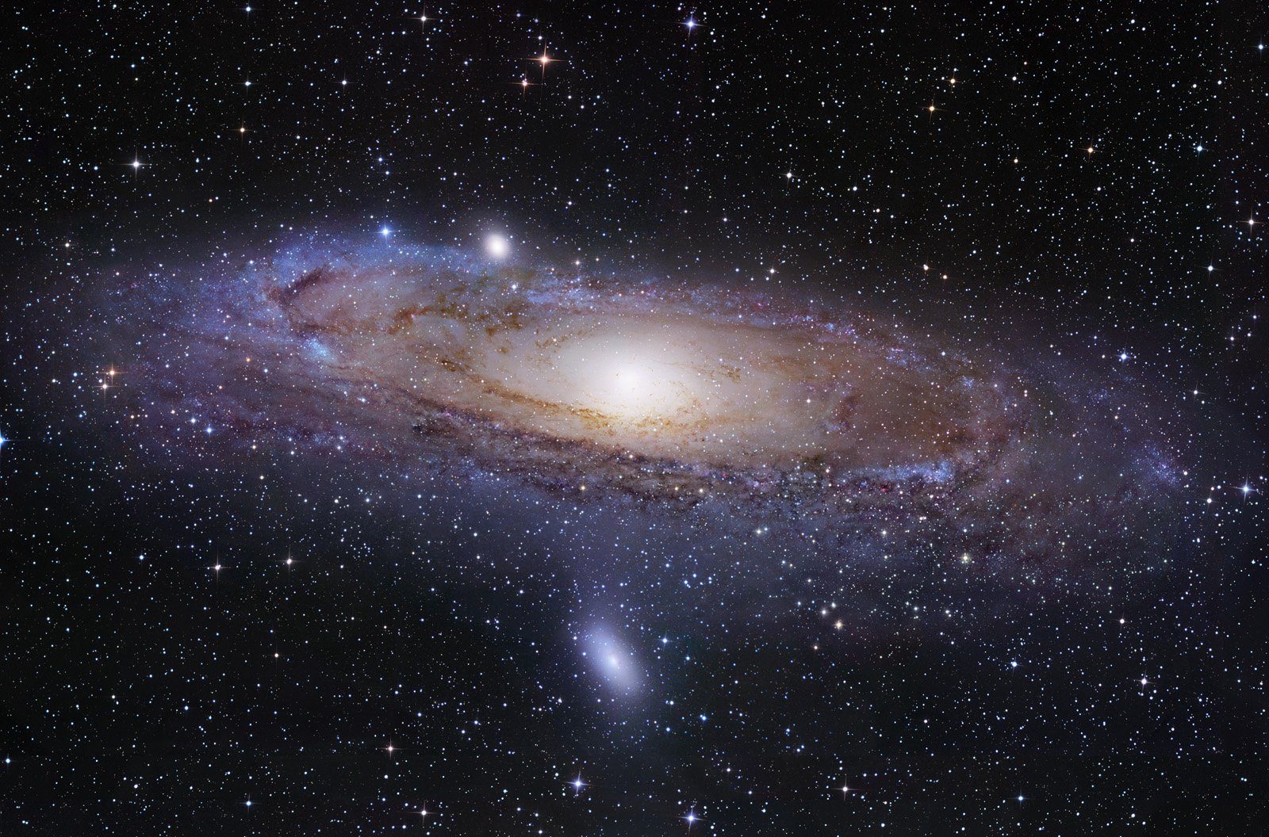
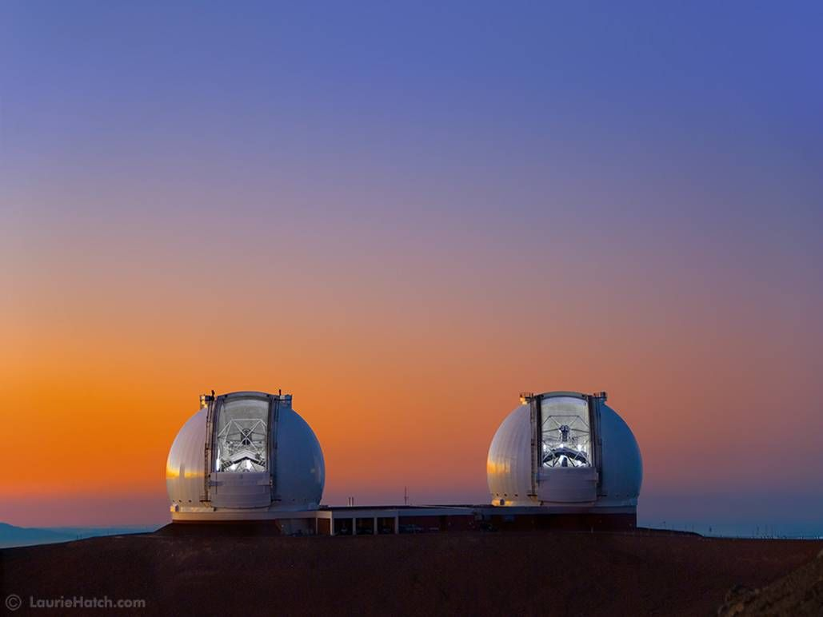


Extent and Kinematics of the
Milky Way’s Stellar Halo
and
Dynamical Heating of the Disks of
Andromeda (M31) and Triangulum (M33)
Raja GuhaThakurta
Thursday, December 8, 2022 Unsolved Problems in Astrophysics and Cosmology —Hebrew University, Jerusalem, Israel

Slide 2
Extent and Kinematics of the
Milky Way’s Stellar Halo:
Distant RR Lyrae in the NGVS and Other Time Domain Surveys

Slide 3
Search for Distant Milky Way Halo RR Lyrae Stars in the NGVS Dataset
NGVS = Next Generation Virgo Cluster Survey
CFHT/MegaCam deep wide field (104 deg²) u*giz imaging of the Virgo cluster
Time-domain aspect of NGVS data yields foreground MW halo RR Lyrae
Robust discovery of the most distant RR Lyrae in the MW halo (R_{MW halo} ~ 0.4 D_{MW-M31}!)
Feng, PG, Peng, et al. (2023, in prep)
Notes:
!

Slide 4
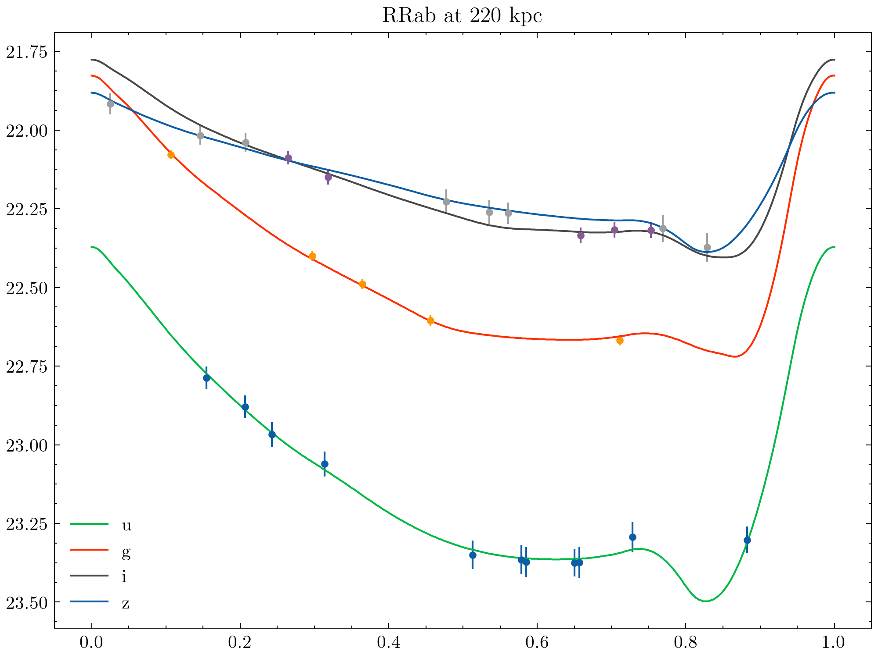
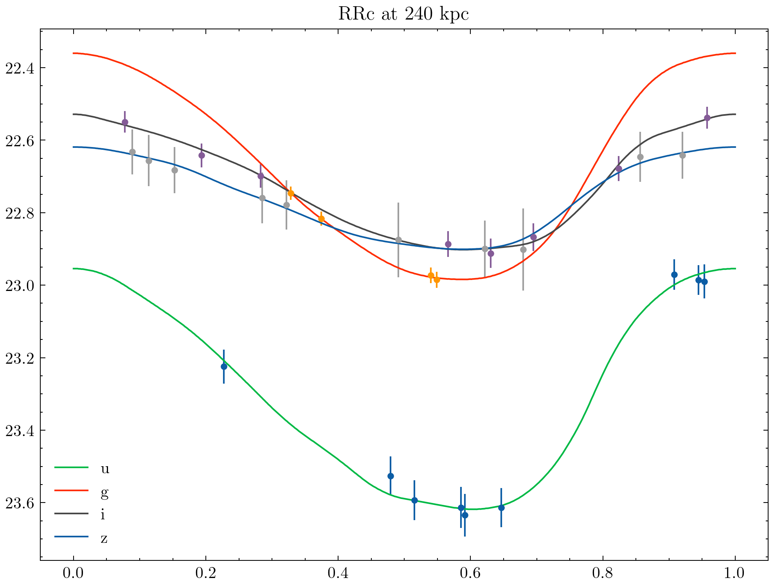
Sample NGVS RR Lyrae Light Curves
~30 data points across four bands (u*giz)
Good photometric precision, especially in the g band
RRab stars are easier to find than RRc stars – larger pulsation amplitude and characteristic light curve shape
Feng, PG, Peng, et al. (2023, in prep)
Notes:
!

Slide 5
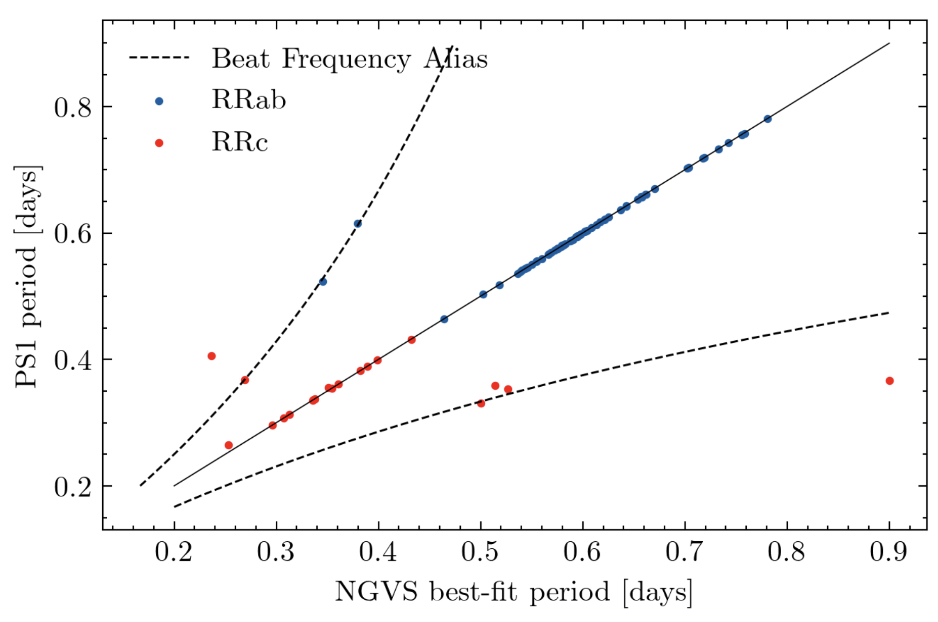
Accurate Measurement of RR Lyrae Periods
NGVS footprint contains 84 PS1 RR Lyrae that are faint enough to be unsaturated
PS1 RR Lyrae sample (Sesar et al. 2017)
Feng, PG, Peng, et al. (2023, in prep)
Notes:
!

Slide 6
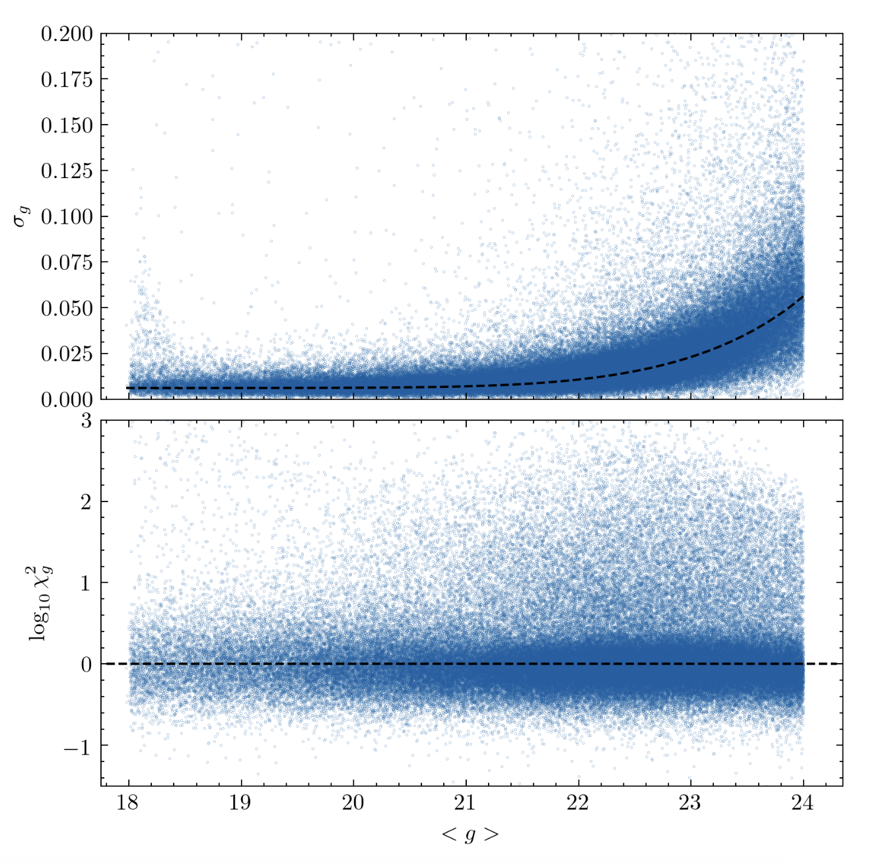
Photometric Depth of the NGVS Dataset
NGVS
HiTS
DES
NGVS single-epoch photometry is
1.7 mag deeper than DES (Stringer et al. 2019)
2.3 mag deeper than HiTS (Medina et al. 2018)
Feng, PG, Peng, et al. (2023, in prep.)
Notes:
!

Slide 7
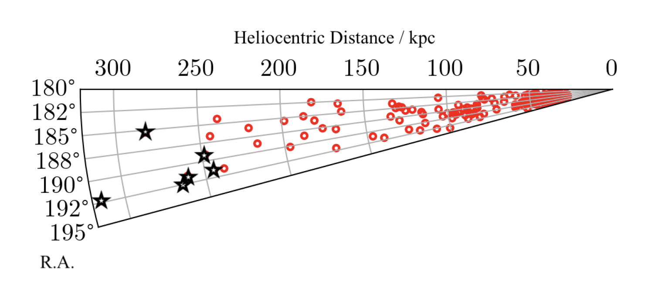
Distant Milky Way Halo RR Lyrae in NGVS
Feng, PG, Peng, et al. (2023, in prep)
Notes:
!

Slide 8
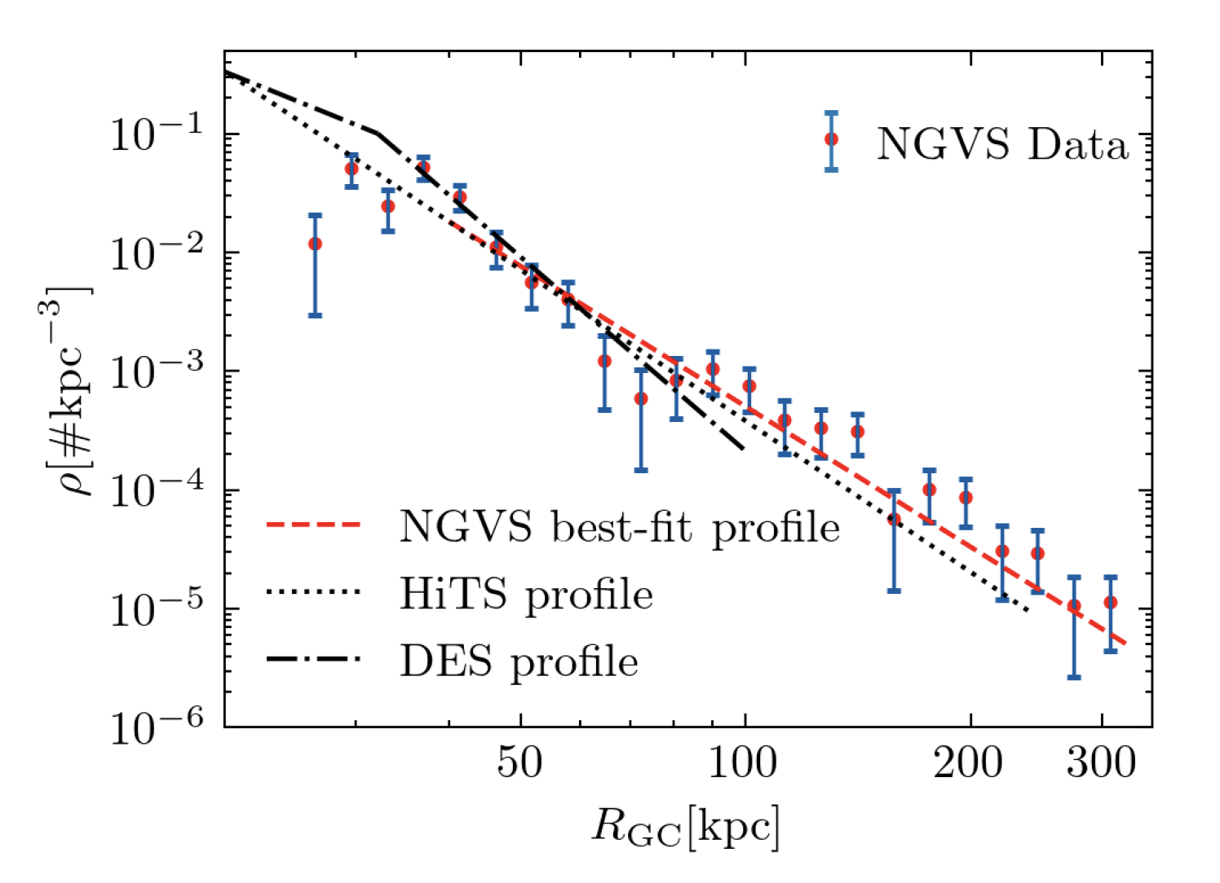
Milky Way Stellar Halo Radial Density Profile
Feng, PG, Peng, et al. (2023, in prep)
Notes:
!

Slide 9
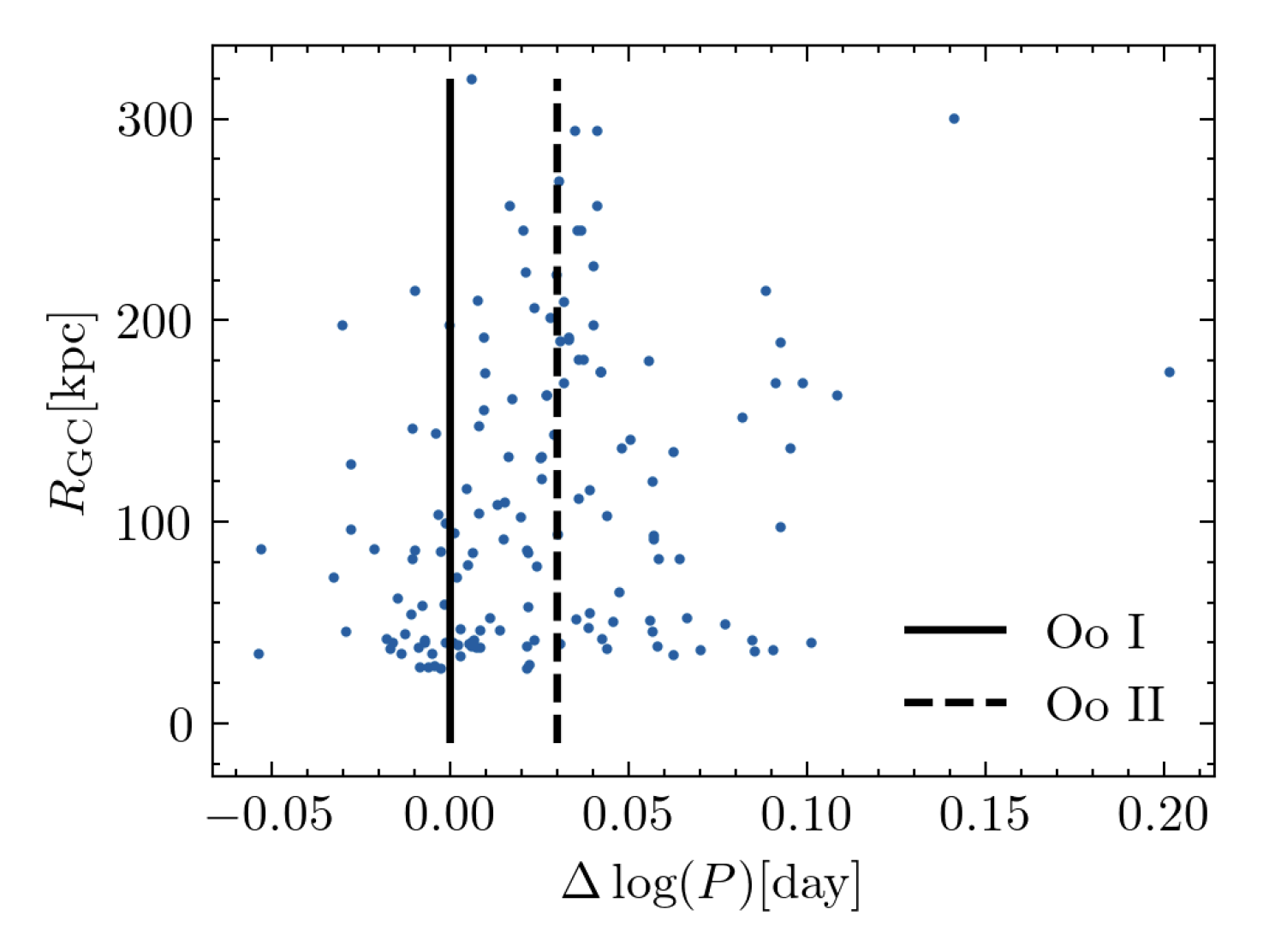

Milky Way Stellar Halo Radial Metallicity Profile
Yuting Feng
(UCSC PhD student)
Feng, PG, Peng, et al. (2023, in prep)
Notes:
!

Slide 10
Dynamical Heating of the Disks of M31 and M33
Notes:
!

Slide 11
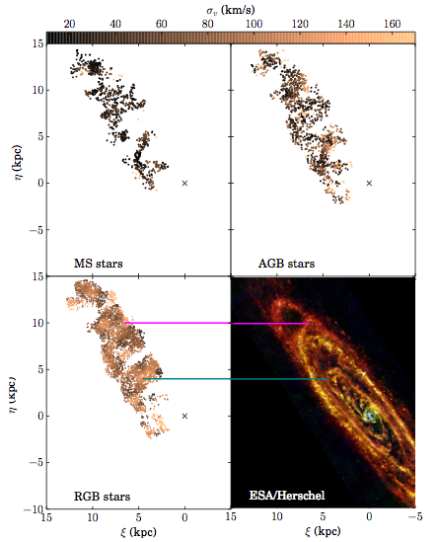
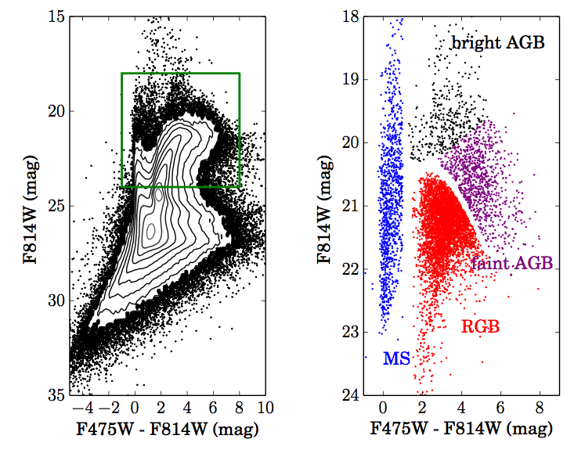
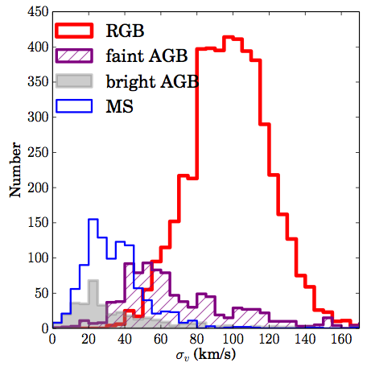
M31 disk kinematics using stellar tracers of different ages
Young
Intermediate age
Dorman, PG, et al. (2015)
Old

Slide 12
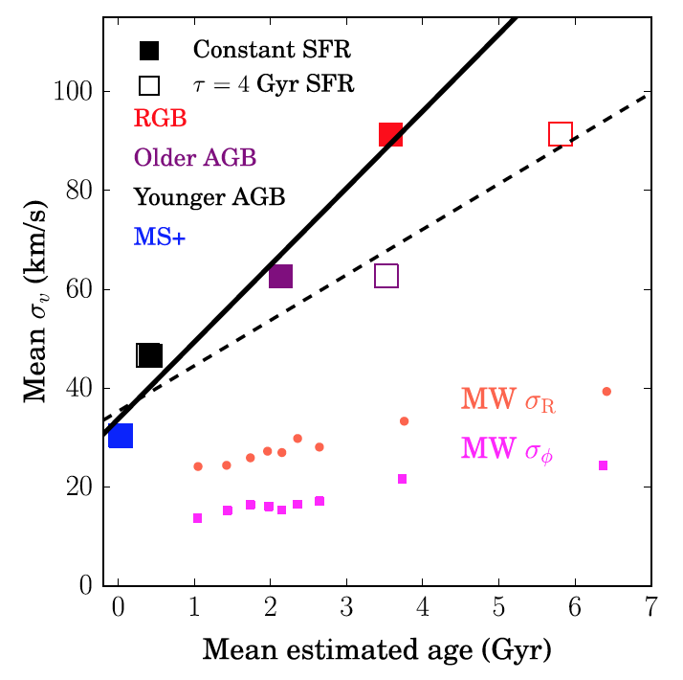

Longer lived stars display more irregular disk kinematics
Claire Dorman
(UCSC PhD 2015)
Dorman, PG, et al. (2015)

Slide 13
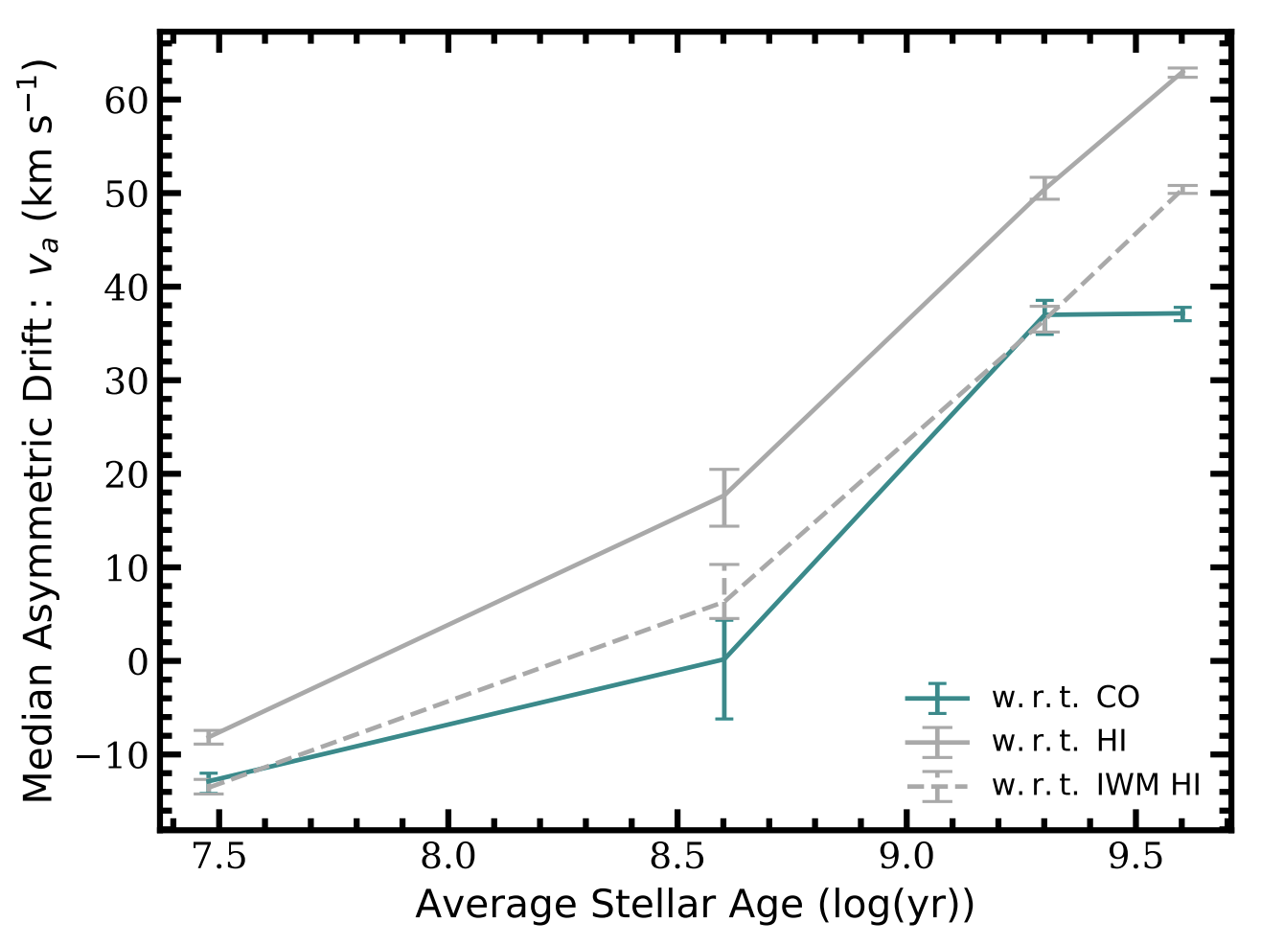
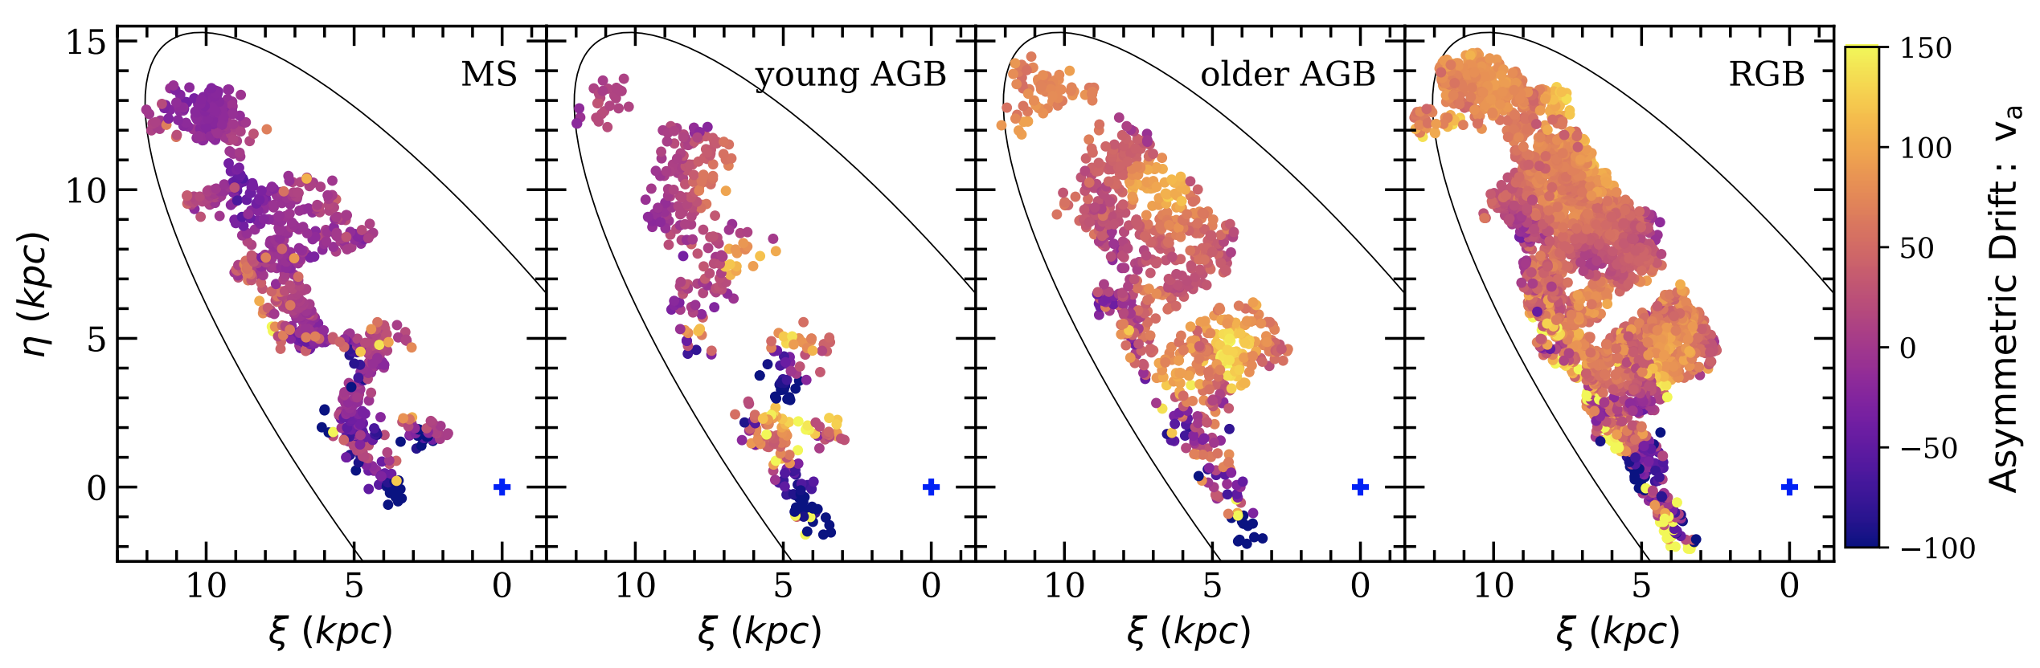

Longer lived stars have a larger asymmetric drift with respect to atomic and molecular gas
Quirk, PG, et al. (2019)
Amanda Quirk
(UCSC PhD student)

Slide 14
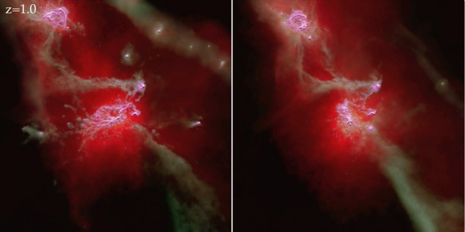
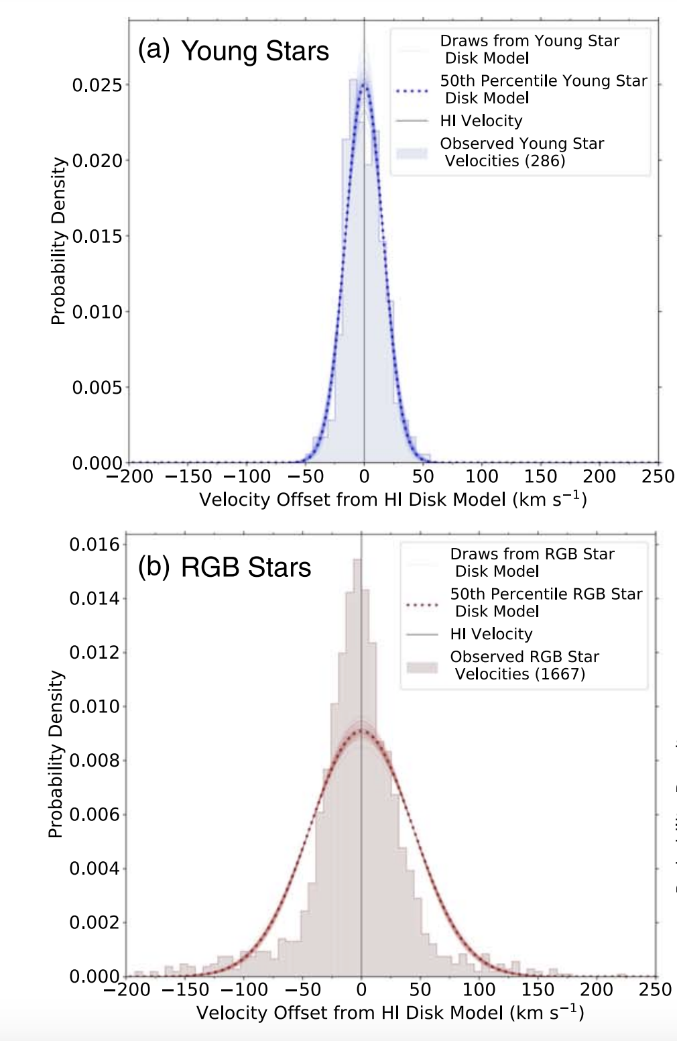
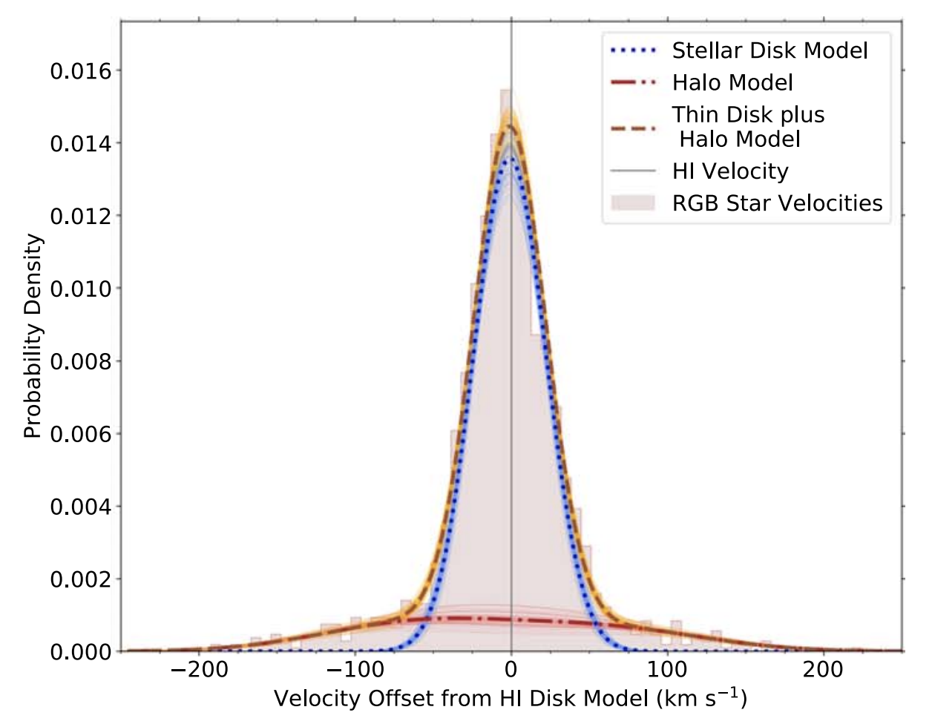
Stellar Kinematics of the Disk of M33
Gilbert, Quirk, PG, et al. (2022)
Notes:
My classification. Useful to agree on this. This one is about environment of stellar populations.....
For models to be sensitive to these, need gas

Slide 15
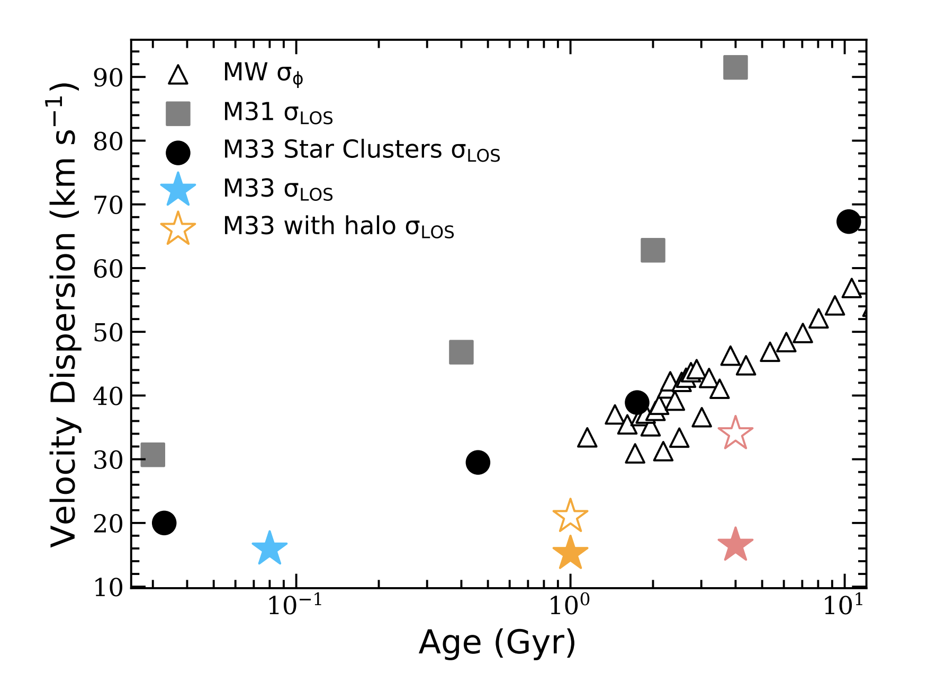
Dynamical Heating of MW/M31/M33 Stellar Disks
Quirk, PG, Gilbert, et al. (2022)
Notes:
My classification. Useful to agree on this. This one is about environment of stellar populations.....
For models to be sensitive to these, need gas

Slide 16
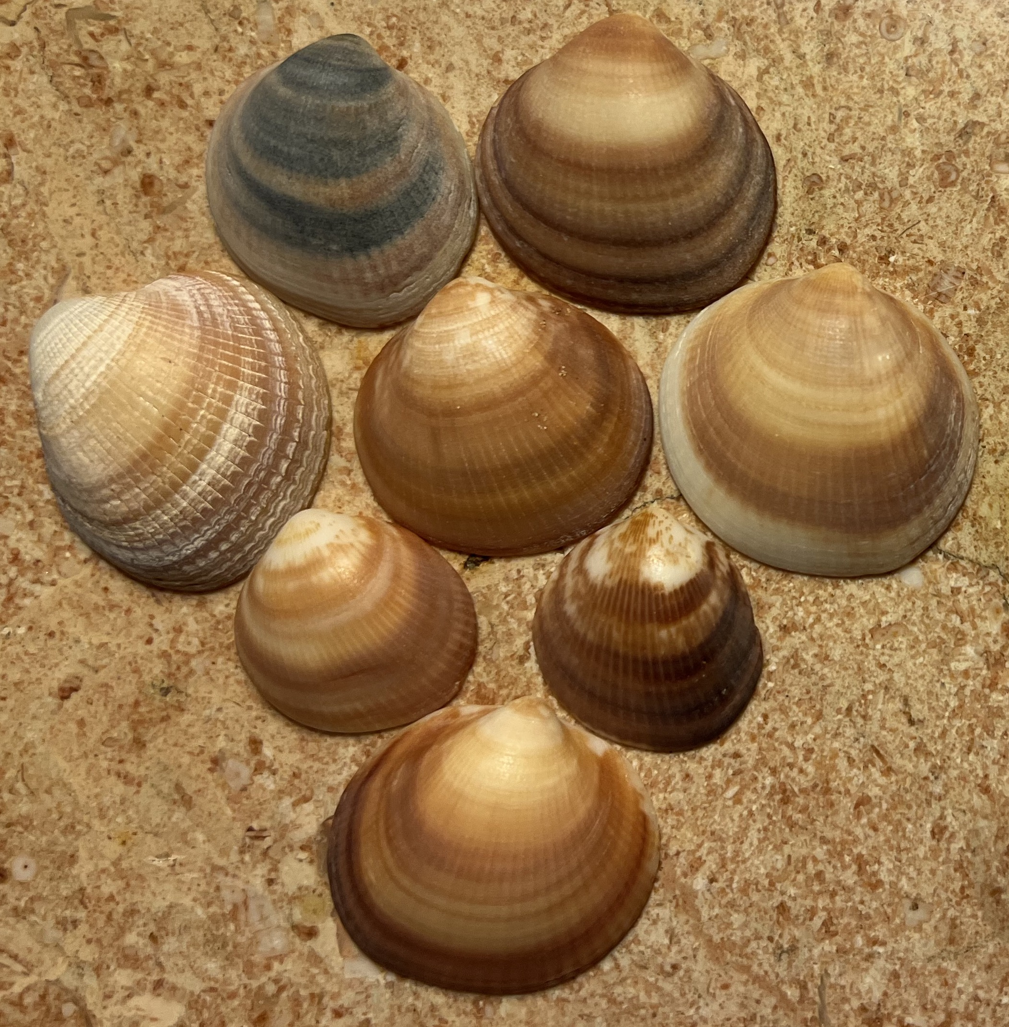
A Particular Minor Merger Event in M31
Forensic reconstruction of the Giant Stellar Stream
Giant Stellar Stream (GSS) debris in M31 can be traced kinematically through three pericentric passages and forms an elaborate system of shells
Gilbert et al. (2007); Fardal, PG, Babul & McConnachie (2007); Gilbert, PG, et al. (2009); Fardal, PG, et al. (2012); Escala, Gilbert, Fardal, PG, et al. (2022a)
Notes:
My classification. Useful to agree on this. This one is about environment of stellar populations.....
For models to be sensitive to these, need gas

Slide 17
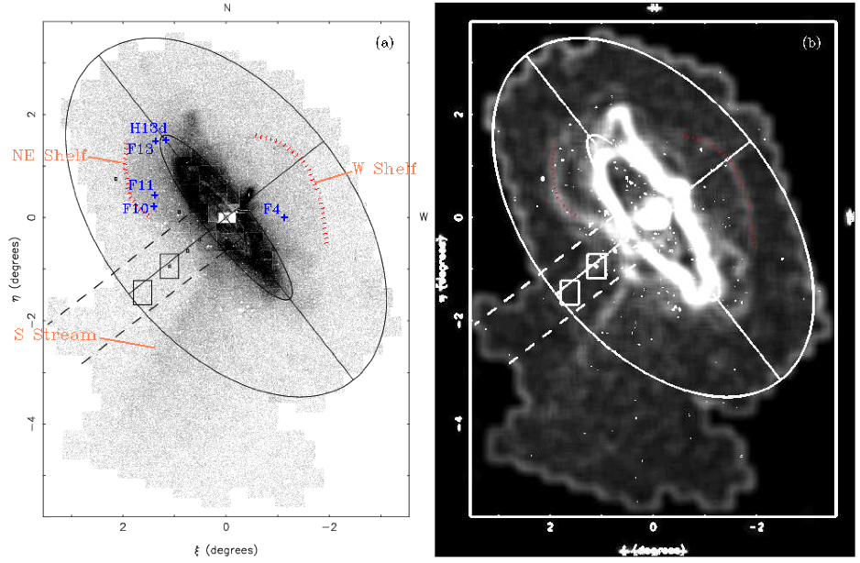
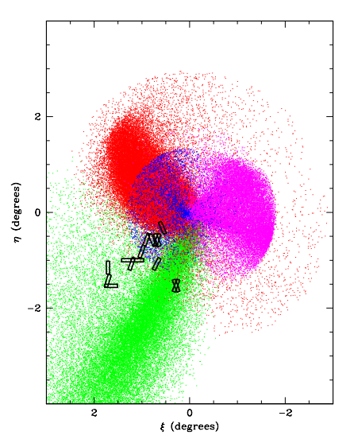
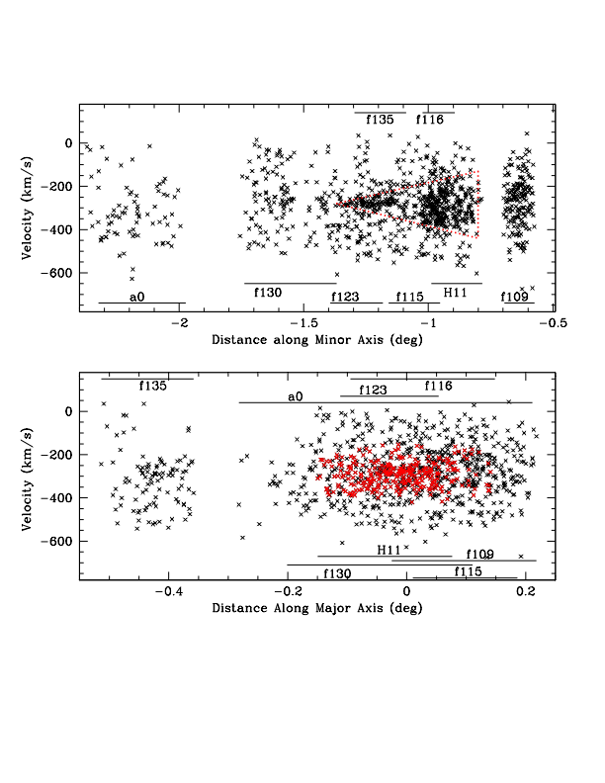
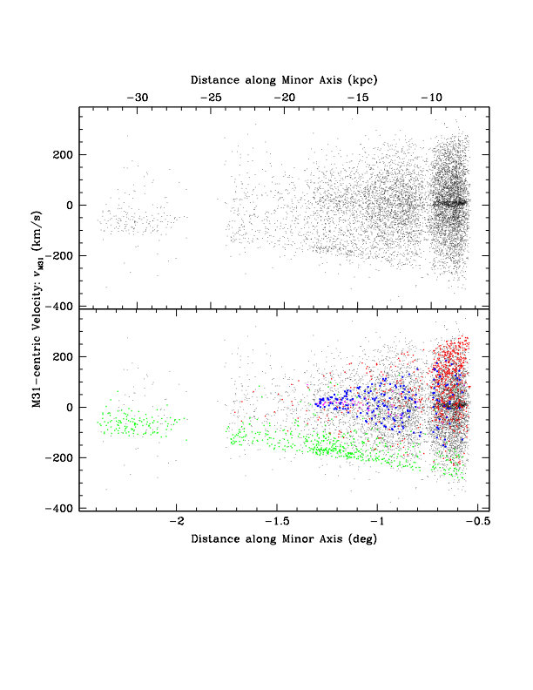
Giant Southern Stream and Young Shell System in M31
NE Shelf
W Shelf
Data
Giant S Stream
Star-Count Map
(Irwin et al. 2005)
Simulation
Simulation
Fardal et al. (2007, MNRAS) Gilbert et al. (2007, ApJ)

Slide 18
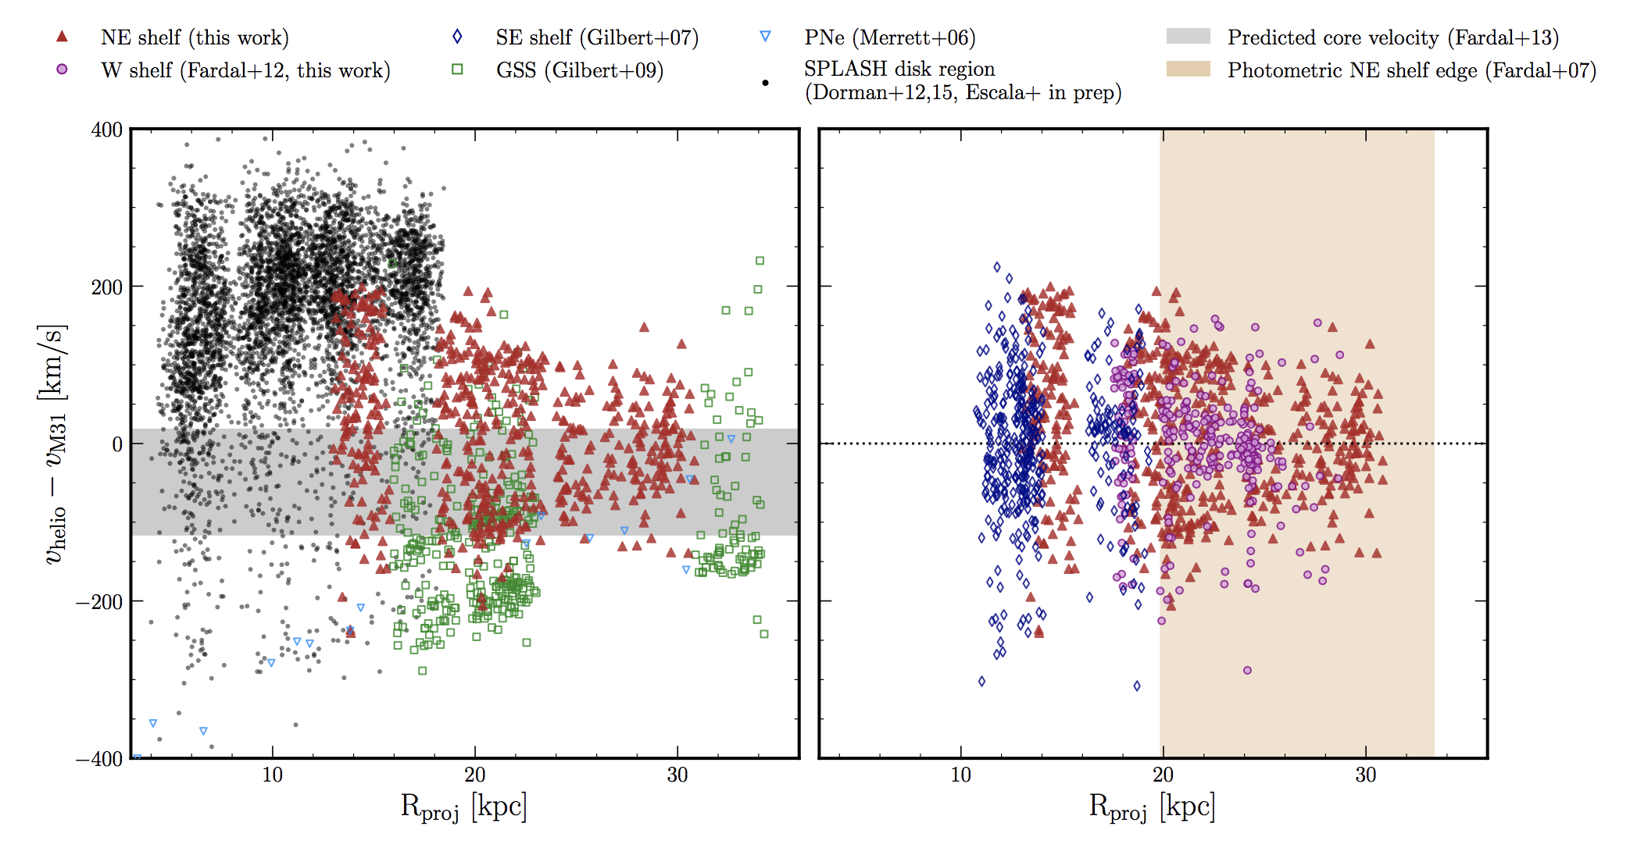
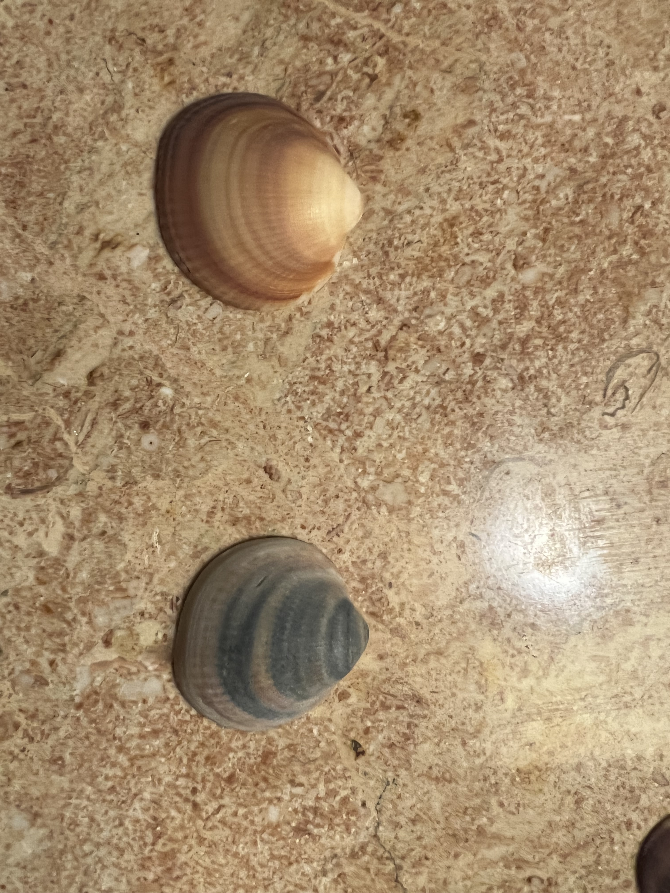
Kinematics of the GSS and Shells in M31
redshifted part of shell
blueshifted part of shell
Escala, Gilbert, Fardal, PG, et al. (2022a)
Notes:
My classification. Useful to agree on this. This one is about environment of stellar populations.....
For models to be sensitive to these, need gas

Slide 19
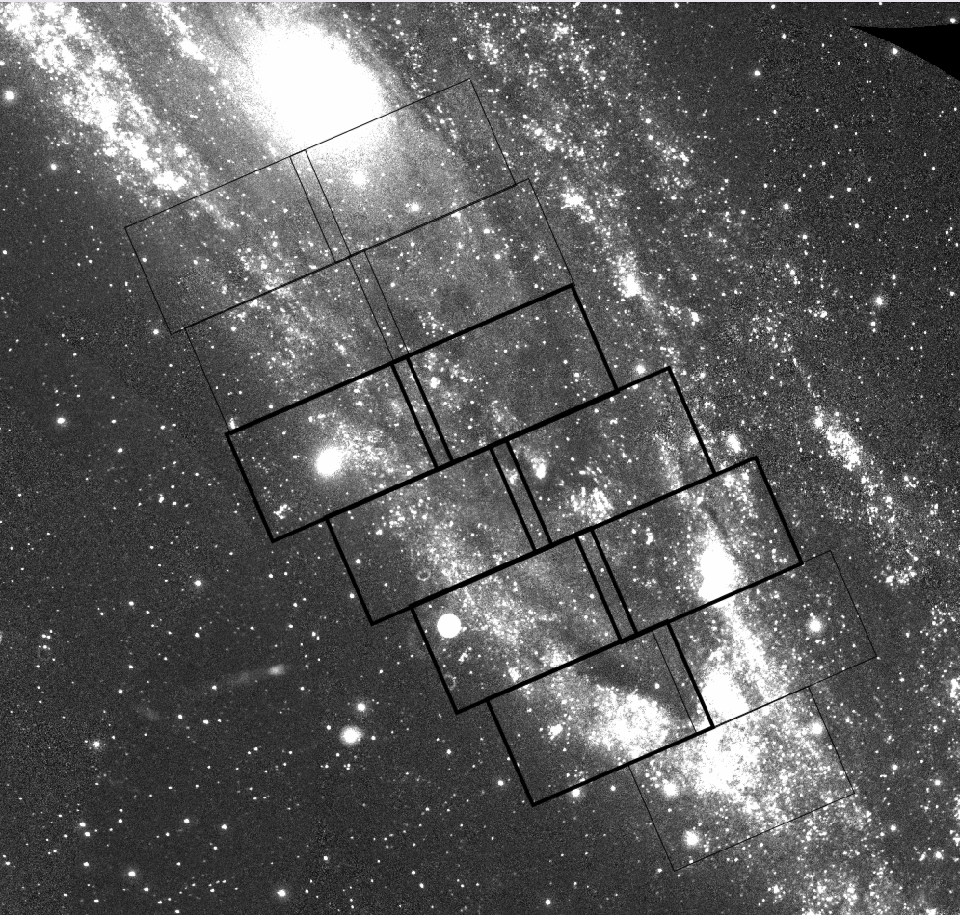
Recent Keck DEIMOS spectroscopy of M32 and M31 disk
M32 masks (2x)
Non-M32 masks (1x)

Slide 20
Open Questions
What is the radial extent of the Milky Way’s stellar halo?
What is the nature of the outer halo kinematics?
What are the primary sources of dynamical heating of the stellar disks of M31 and M33?
Thursday, December 8, 2022 Unsolved Problems in Astrophysics and Cosmology —Hebrew University, Jerusalem, Israel

Slide 21
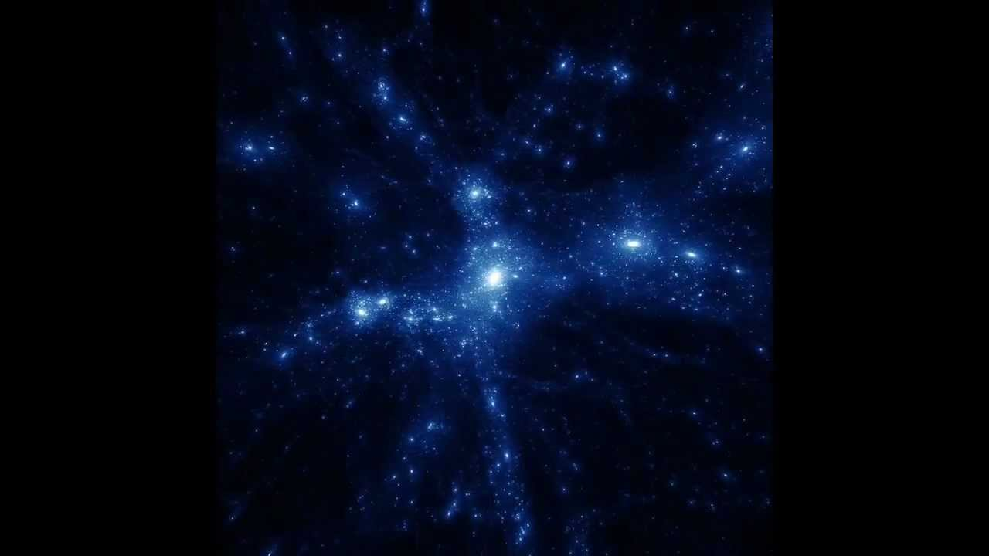
Eavesdropping on Real-Time Science Experiments
Shadow the Scientists

Slide 22
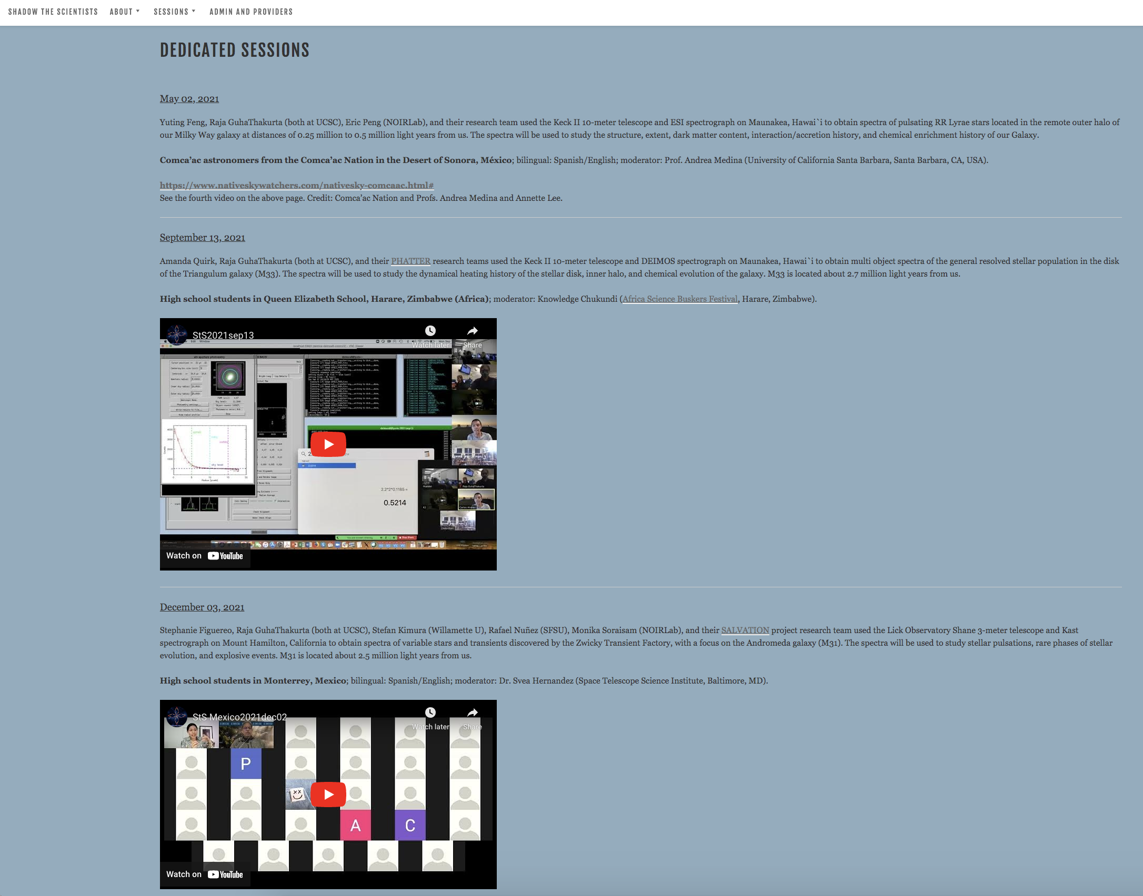
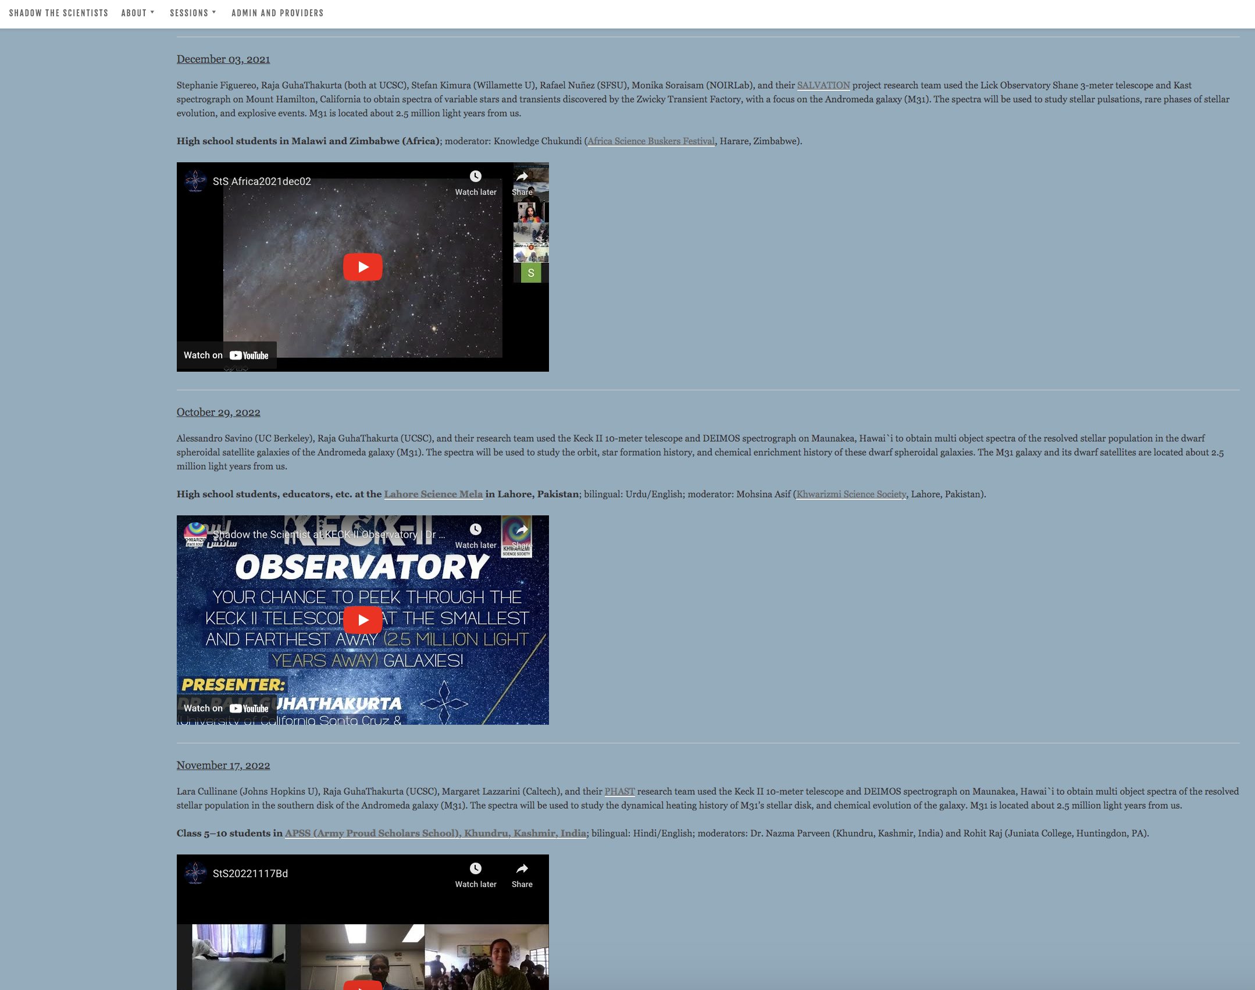
Impact of StS to date
COVID-19 adaptation: “pajama mode observing” – started in November 2020; accelerated in spring 2021
About two open sessions a week at present; global cohort of participants: school through university students, educators, etc.
Six dedicated sessions: Comca’ac Indigenous astronomers in Mexico; school groups in Mexico, Zimbabwe, Malawi, Pakistan, and India (Kashmir); plans to engage Israeli and Palestinian students
Please contact me if you are interested in hosting StS participants during your observing runs!

